Slide 1
SOIL
Agriculture in the Classroom
Lesson to Grown - 9/2011

Slide 2
Why are soils so amazing?
We depend on them for our survival
  Integral to ecosystems worldwide
Soil is fundamental to understanding life on earth
  The final frontier is right under our feet!
It’s where we come from – our home
Oregon Agriculture in the Classroom
Notes:
Scientifically we are increasingly gaining a perspective on how integrated soils are into all earth systems. I can’t think of a single resource-based topic that doesn’t have some connection with soils. If you are interested in the environment, you couldn’t start at a better place.
Soils are totally fundamental for understanding life on earth.
Fascinating natural bodies
Soils are just fun to study and relate to so many other things
VAST WORLD TO UNDERSTAND
Fun to teach too
Final Frontier
There is just so much to discover
They are underground and mysterious
Where we come from…Literally. One hypotheses is that life on the planet had it’s start in clay films.
We have a complex association with soil. While it is debatable that we may literally come from them,
there is no debate that soils sustain us.

Slide 3
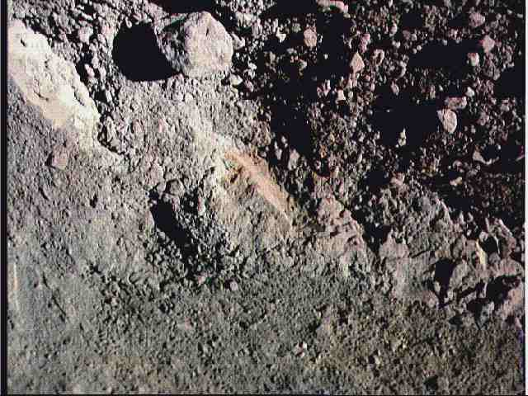
Notes:
Look at this photograph of surface soil. Do you see anything unusual about it? Would you expect to be able to plant a tree and have it successfully grow?
Note that this soil is mineralogical identical to that below your feet.
However, this soil is missing two very necessary ingredients, and thus can not sustain plant life.
To help us identify what it is missing we need to take a slightly wider angle perspective of the area where it is found.

Slide 4
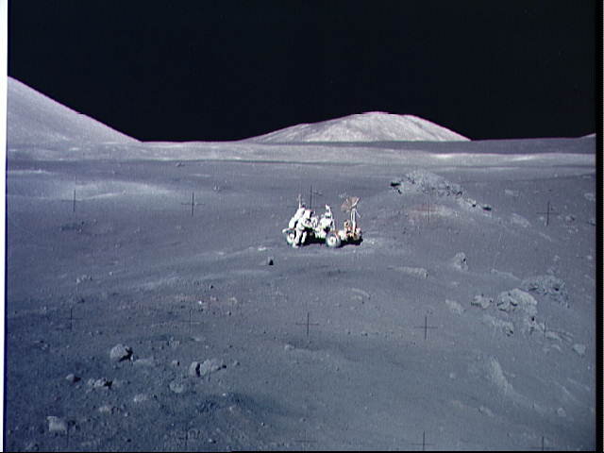
Oregon Agriculture in the Classroom
Notes:
That’s right, the moon has the same mineralogical composition as you would find in an andesite type soil. However, it is missing air and water.

Slide 5
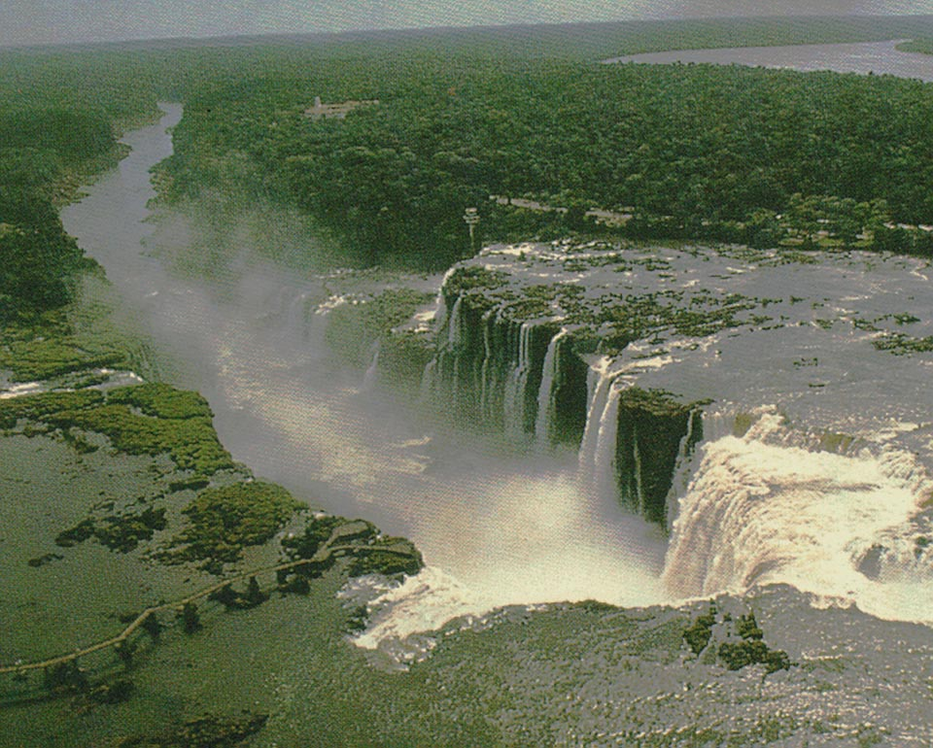
Notes:
If we take a closer look at the surface of the earth we find that because of this combination of water and air, the earth is able to sustain an abundant variety of plant and animal life, making the earth a far more hospitable planet than any other in our solar system.

Slide 6
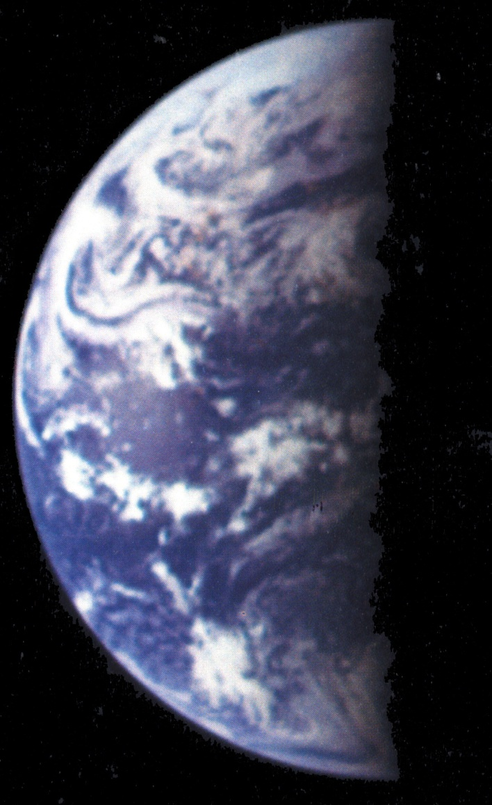
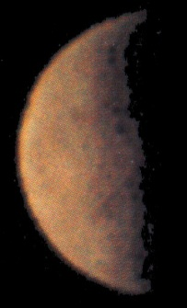
Earth
Moon
Oregon Agriculture in the Classroom
Notes:
If we look at both the earth and the moon from space, we find the Earth is much larger, four times the diameter of the moon.
Because of its larger mass the earth has a much greater gravitational field and is able to keep atmospheric gases from evaporating into space, unlike the moon.
In addition, the earth is just close enough to the sun that water stays preferably in a liquid state. Were it as close to the sun as Venus, all liquid water would be turned into vapor, if it were as far as Mars, liquid water would not exist either since it would all be frozen.

Slide 7

Earth
The rest of the universe
Notes:
Wow.

Slide 8
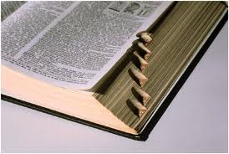
Soil defined
soil/
Noun: The upper layer of earth in which plants grow, a black or dark brown material typically consisting of a mixture of organic remains, clay, and rock particles.
Verb: Make dirty: "a soiled T-shirt"
Oregon Agriculture in the Classroom
Notes:
This is a definition of soil in the dictionary. It can be a noun or a verb. This definition is missing some important information about soil. Primarily that soil is absolutely essential to the formula for life on Earth.

Slide 9
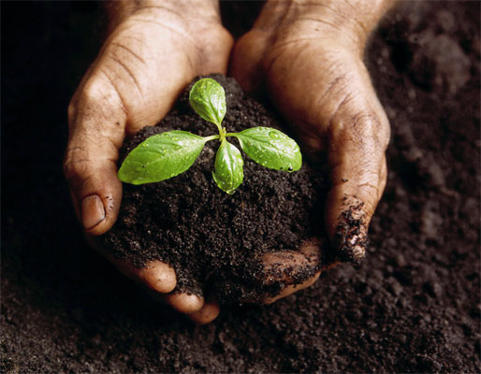
Soil is ALSO…
Soil (along with air and water) is one of the three major natural resources on earth.
Without soil there would be no life on earth.
Oregon Agriculture in the Classroom

Slide 10
Why it is important to study soil
World population is increasing
Only a small fraction of the world’s land is suitable for growing crops
Quantity of farmland is getting smaller
Soil quality for agriculture is degrading world-wide
Oregon Agriculture in the Classroom
Notes:
Link to the Earth is an Apple Lesson, and or the video stream for Farmland Trust.
Look at this link for a world clock http://www.tranquileye.com/clock/ of population growth and soil loss. Very humbling web site.

Slide 11
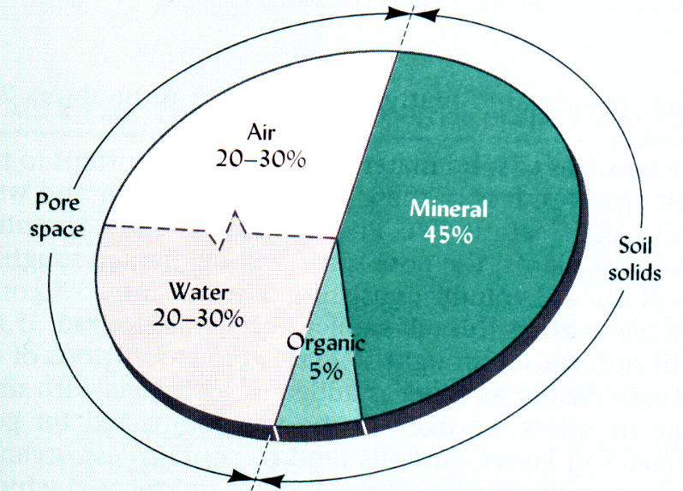
What is soil made of?
The 4 Elements of Soil
  Minerals - from rocks
  below or nearby
  Organic Matter -
  the remains of plants
  and animals
  Water
  Air
Oregon Agriculture in the Classroom

Slide 12
What is soil made of?
A clump of soil will have water, air, organic matter,and minerals.
m
O
w
w
m
a
a
A = Air
W = Water
O = Organic Matter
M = Minerals
m
m
w
m
m
a
O
Notes:
This image represents what you would find in a clump of soil if it could all be labeled.

Slide 13
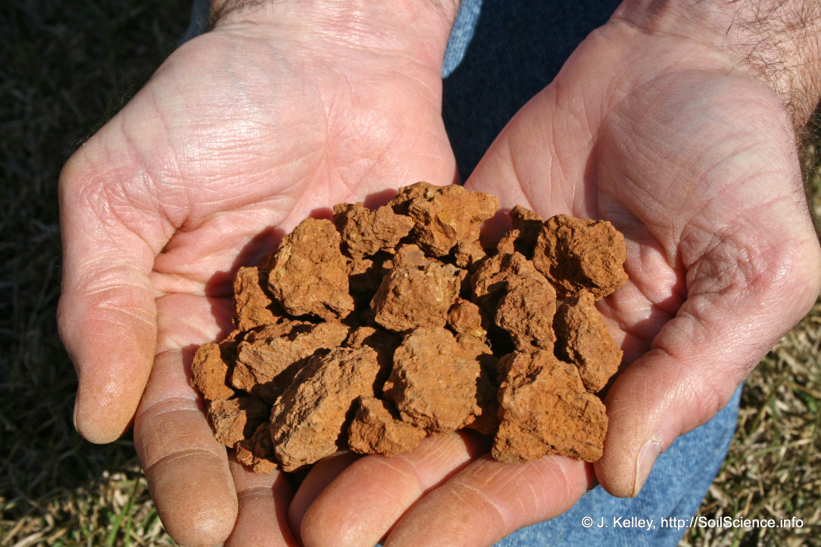
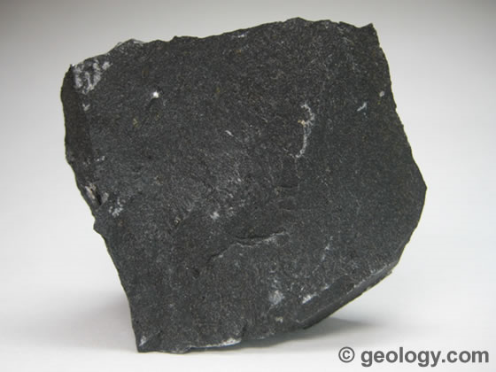
Minerals
Makes up less than 50% of a “soil”
Chemical composition varies
Contains particles of several sizes (small to really small) i.e, Sand, Silt, Clay
The minerals in a soil depend on the underlying geology/bedrock
Notes:
Images: Sand, silt, clay (minerals) and organic matter (OM) bind together to provide structure to the soil.
Images: Basalt (L), an Igneous rock is formed from the solidification of molten rock material. As these rocks break down they are become part of soil.
Lesson link – Three Types of Rocks

Slide 14
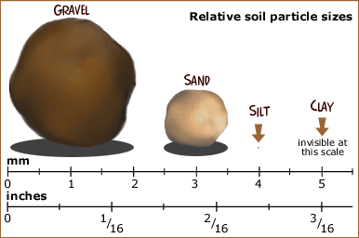
Notes:
Every soil type is a mixture of sand, silt, clay, and organic matter.
Soil Particle Sizes
Gravel: larger than 2mm; feels coarse
Sand: 2 - 0.05mm; feels gritty
Silt: 0.05 - 0.002mm; feels like flour
Clay: smaller than 0.002; feels sticky when wet
Sand: Soils with lots of sand have big spaces between the particles. They don't hold water or nutrients. Sand doesn't react with other chemicals. Sandy soils don't stick together very well. Plant roots can't hold onto this soil. But the big spaces do allow air into the soil. There are some plants that are able to grow in sandy topsoil by putting their roots deep, through the sand to the subsoil.
Silt: This material is finer than sand, but still feels gritty. Silt is commonly found in floodplains and is the soil component that makes mud. Soils with a lot of silt make excellent farmland, but erodes easily. This soil can be easily blown away in dust storms and carried down stream in floods.
Clay: Lots of clay will make the soil heavy and dense. The spaces between soil particles are very tiny in clay soil. When clay soil is dry, it's almost as hard as concrete. Plant roots can't push through it. No air can get in from the surface. Most bacteria and other soil organisms that need oxygen can't breathe. BUT - clay is important because it can change the soil chemistry. Clays give off minerals and absorb acids.

Slide 15
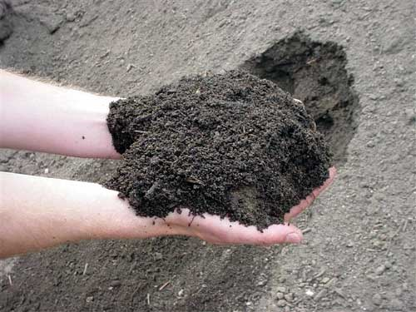
Loam – The perfect mix for agriculture.
Oregon Agriculture in the Classroom
Notes:
Loam: This is the “perfect” soil for plants and soil organisms. It has about the same amount of sand and silt, plus a smaller amount of clay. This soil has enough large and small spaces for air and water to flow. It also has enough clay to let it stick together and hold humus. These clumps make varying spaces in the soil. Plant roots can easily grow through these spaces. This is what farmers and gardeners are talking about when they call a soil "aloam" or "loamy“ soil.
It's the nicest thing you can say about a soil.

Slide 16
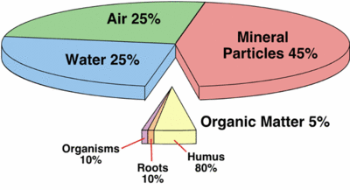
Organic Matter (OM)
SOIL GLUE – it is small part of soil, but has a huge influence on soil properties.
Made of decomposed plants and animals, roots and humus.
Notes:
OM is small, but mighty – vital for making soil.

Slide 17
What does organic matter do?
Gives Soil Structure - Stabilizes soil, makes soil easily managed SOIL GLUE!
2. Holds Water - Increases the amount of water a soil can hold (and it’s availability to plants)
3. Major source of nutrients for plants
4. Main food/energy for soil organisms
Oregon Agriculture in the Classroom

Slide 18
Soil Water
Soil holds different amounts of water depending on soil pore size and water available.
Water accumulates in empty pore spaces.
Not all soil water is available to plants.
Oregon Agriculture in the Classroom
Notes:
On average, anywhere from 40% to 60% of the volume of a mineral soil is actually empty space between the solid particles (voids). These voids are filled with air and/or water.
Big thought – Sometimes people think of soil and they focus on the solids (minerals and organic matter). However, the addition of oxygen and water is what makes soil form - and in essence, life form.

Slide 19
Soil Air
Oxygen in soil is used by plant roots and soil microbes.
  during respiration carbon dioxide is released.
High CO₂ content
Low O₂ content
Soil air is very humid, close to 100%
Oregon Agriculture in the Classroom

Slide 20
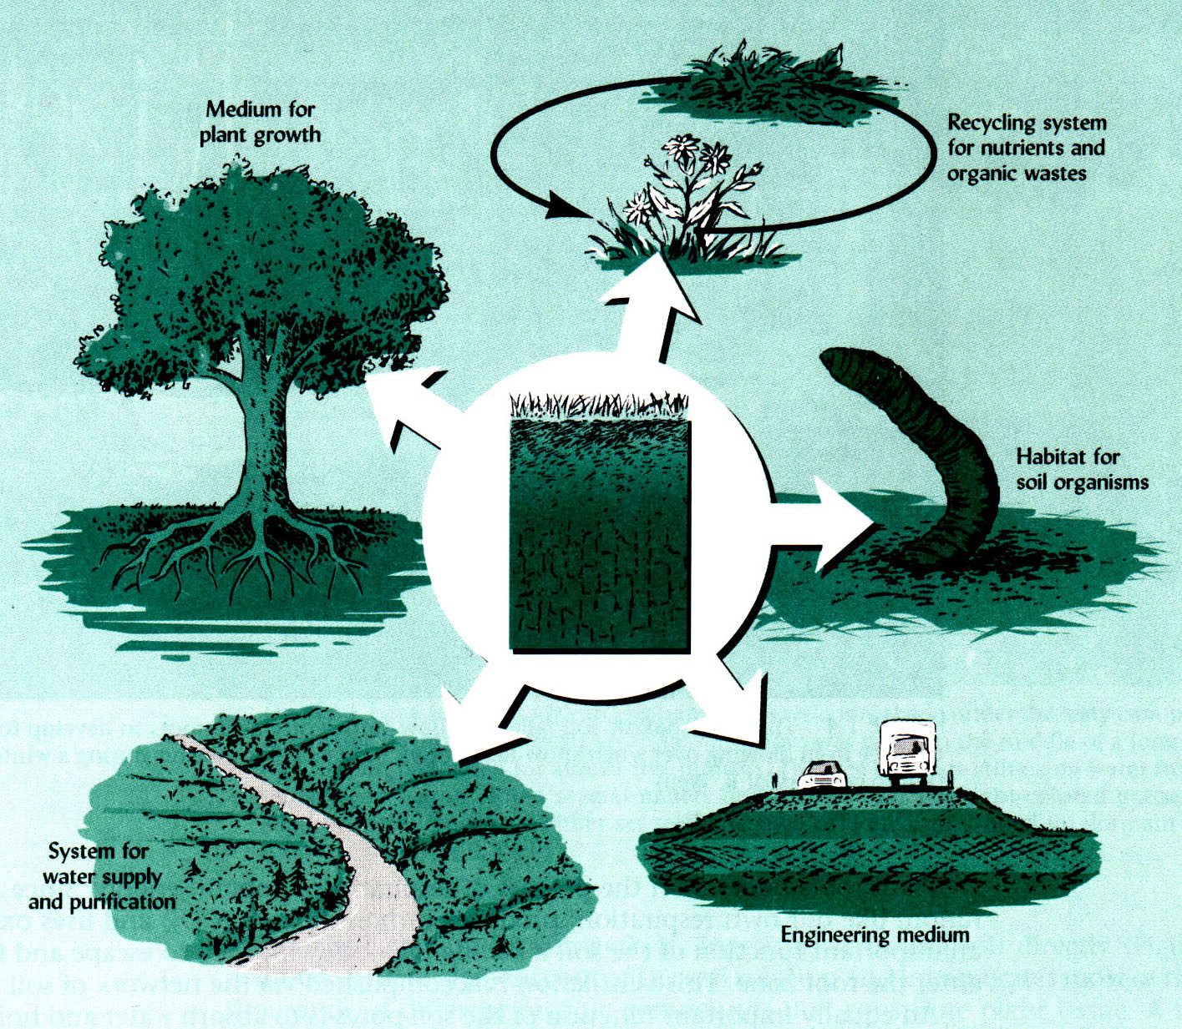
Place for plants to grow
2
Recycles nutrients and Organic Material
1
Habitat for soil organisms
5 functions of soil
3
5
Water supply & purification
4
Human and Animals Build with it

Slide 21

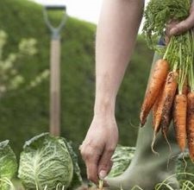
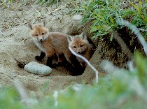
5 Functions of Soil
  #1 Supports plant growth and animal life below and above the surface.
Oregon Agriculture in the Classroom
Notes:
SOIL is A LIVING THING! Soil is an ecosystem onto itself; a complex, 4-dimentional habitat;
an integral part of a larger ecosystem affecting both terrestrial and aquatic processes.
Soil is absolutely crucial for life on earth.

Slide 22
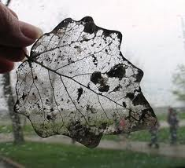
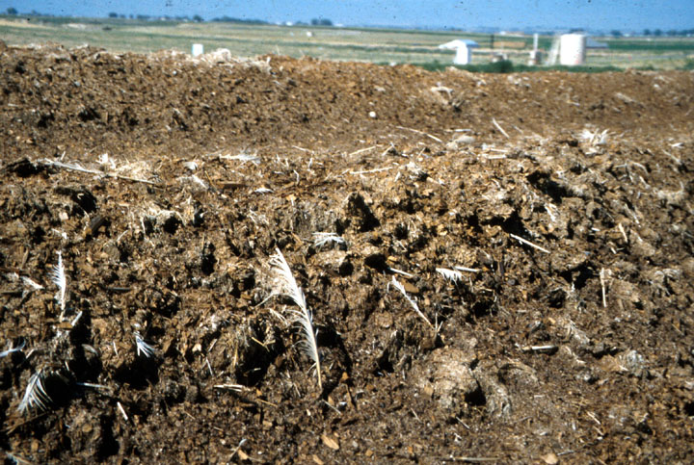
5 Functions of Soil
  #2 Recycles nutrients and waste – DECOMPOSTION.
Oregon Agriculture in the Classroom

Slide 23
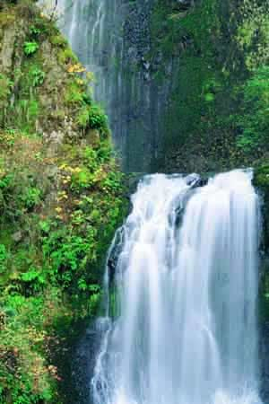
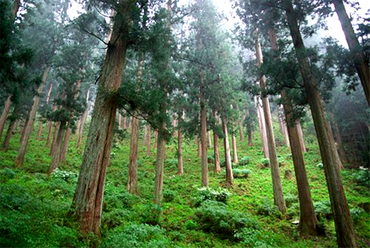
5 Functions of Soil
  #3 Controls the flow and purity of water!
Oregon Agriculture in the Classroom
Notes:
Lesson link – Soil as a Water Filter
Soil is the reason we have clean water. 1/3 of the drinkable water on the planet is stored in soil.

Slide 24
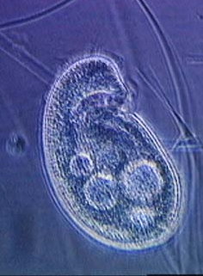
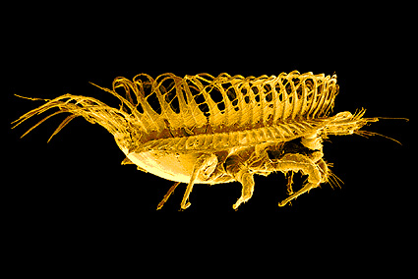
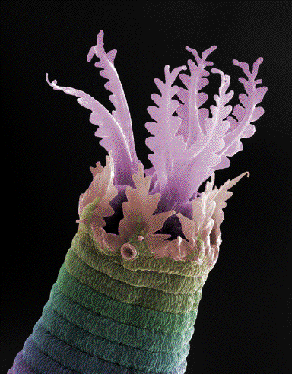
5 Functions of Soil
  #4 Provides habitat for soil organisms.
  - Billions of organisms per pinch of soil!
Protozoa
Soil Animals – micro, meso, macro
Oregon Agriculture in the Classroom
Notes:
In a pinch of soil there are thought to be a BILLION organisms. These creatures above and billions more are right below our feet. There is more diversity in soil than our oceans or any other place on the planet.

Slide 25
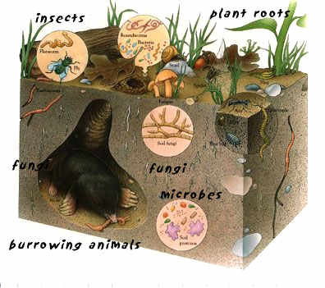
Soil is the Basis of the Ecosystem
There is a world under our feet!
Notes:
We often ignore soil, BUT
The living systems occurring above and below the ground surface are determined by the properties of the soil.

Slide 26
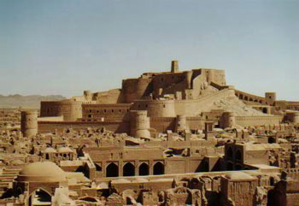
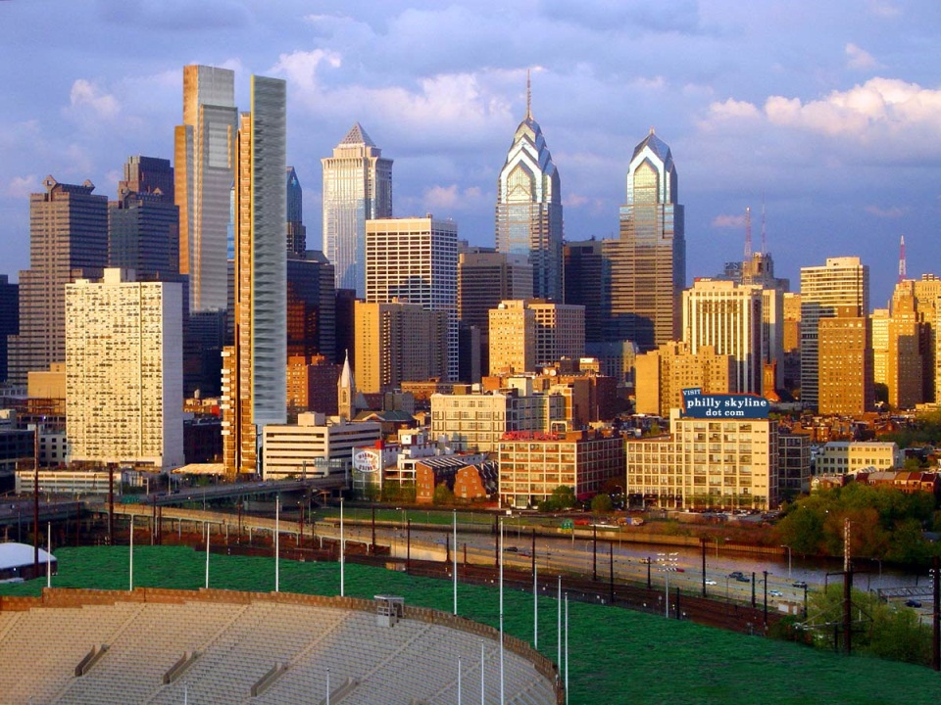
5 Functions of Soil
  #5 The base for building materials.
  Most of human history people live in earth buildings. Other animals use soil as a building material (ants, termites, mud dobblers, et al)
Oregon Agriculture in the Classroom
Notes:
From ancient mud cities like Bam, Iran a World Heritage Site (L) to major modern ones like Portland, Oregon builders are using soil to build with or on.
Note Bam was leveled in 2003 in a massive earthquake.

Slide 27
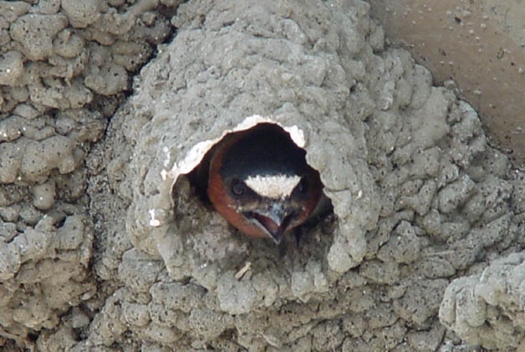
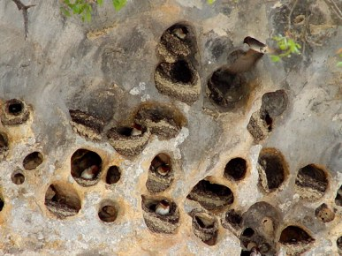
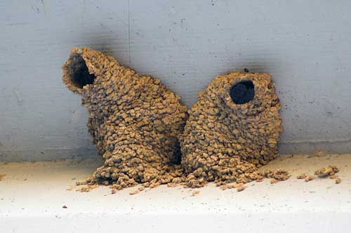
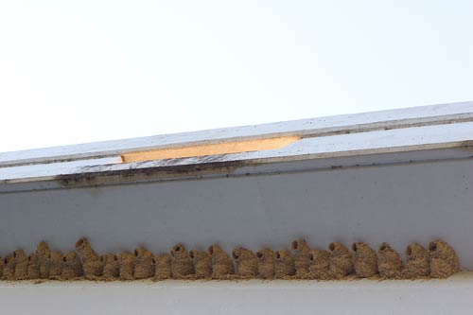
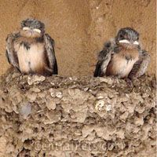
Cliff Swallow
Petrochelidon pyrronota
Notes:
Here a variety of birds make their homes from mud. Can your students think of other animals that build their homes out of soil?

Slide 28
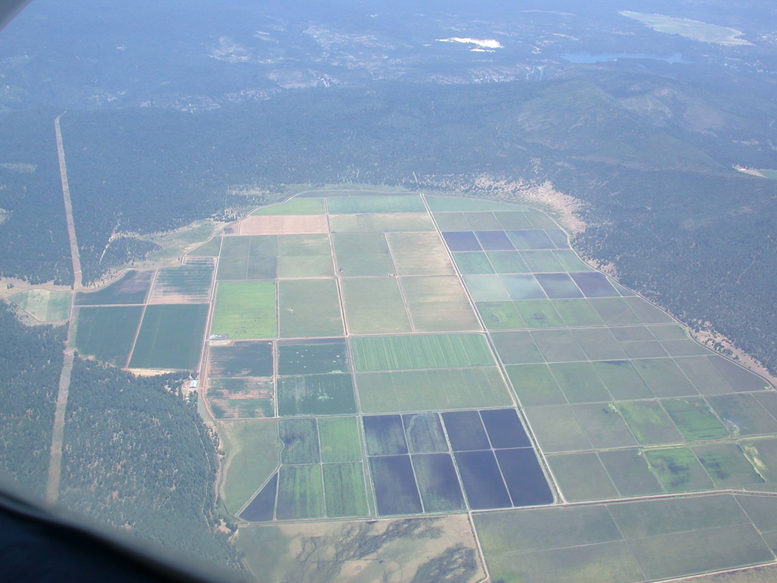
Soil Genesis
How is soil made?

Slide 29
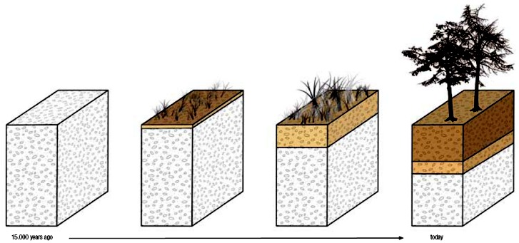
How is Soil Made?
The process is called pedogenesis.
- Many processes working together lead to the formation of soil.
Notes:
Soil forming - in this image, beginning 15,000 years ago on the left hand side with rock. The rock breaks down due to chemical and physical factors, organic matter forms, more rock is broken down, horizons form. You have the creation of a soil horizon and it just took 15,000 years.
Needless to say soil forms slowly.

Slide 30
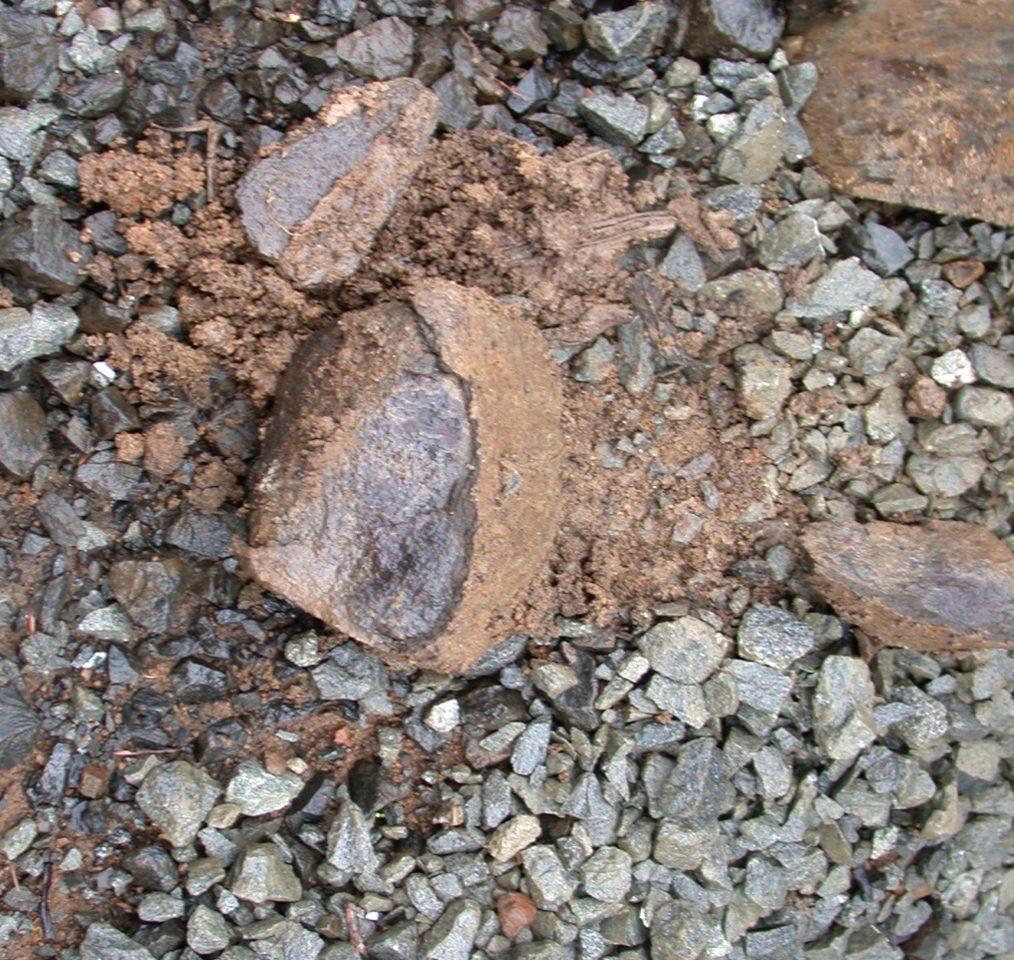
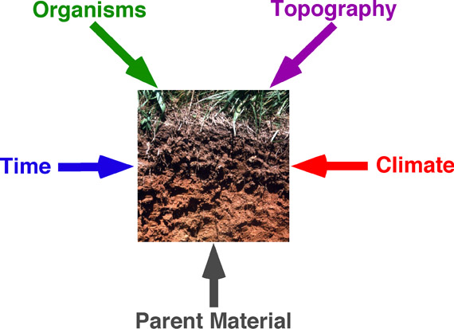
How is Soil Made?
Step 1: Physical and chemical weathering breaks rock down into smaller piece.
Notes:
Climate, Organisms, Relief (Topography) Parent Materials, Time (Cl, O, R, P, T) are factors that work within physical and chemical weathering to break down rocks.

Slide 31
5 factors that effect soil formation
Cl, O, R, P, T
Climate
Organisms
Relief/Topography
Parent Material
Time
Active Factors
Passive Factors
Oregon Agriculture in the Classroom
Notes:
These factors effect the physical and chemical weathering of rocks and formation of pioneer organisms that lead to the formation of soil.

Slide 32
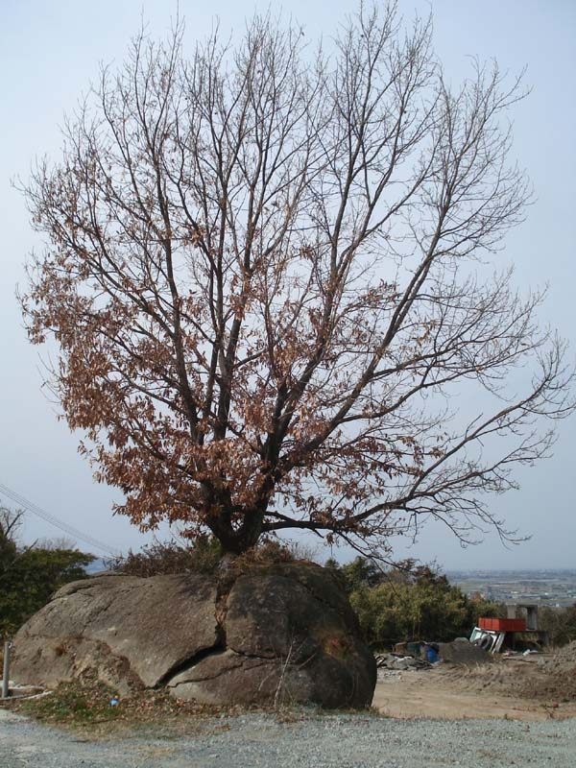
Rock Weathering – Physical Causes
Freeze-thaw
Uneven heating (exfoliation)
Shrink-swell (dry-moist)
Abrasion (water, wind, ice)
Organisms (like tree roots)
Notes:
Lesson link – Rocks to Soils.
The roots of the tree are breaking up the rock. Ask students to think of examples of these physical weathering factors. For example, glaciers = abrasion.
Types of Weathering –
Physical Weathering - the mechanical breaking of rocks, possibly by freezing and thawing, exfoliation, crystal growth within fractures an biogenic fracturing (root growth).
Freezing and Thawing, Wetting and Drying, Grinding or Rubbing, Organisms. This web site has great examples.
http://www.soil-net.com/legacy/advanced/soil_formation3.htm

Slide 33
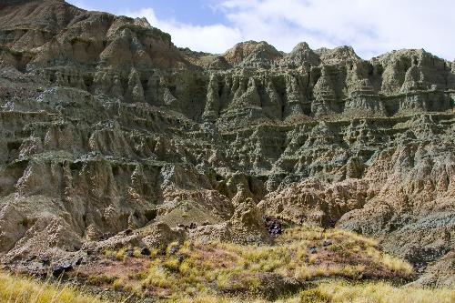
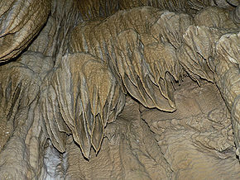
Rock Weathering – Chemical Causes
Oxidation - oxygen interacts chemically with minerals
Hydration - water interacts chemically with minerals
Carbonation - carbon dioxide interacts chemically with minerals
Carbonation at the Oregon Caves.
Notes:
Chemical weathering includes a variety of chemical reactions that break down the primary minerals of the rock.
Chemical weathering occurs when a rock is broken down by chemical action resulting in a change in the composition of a rock. The main agents of chemical weathering are oxygen, rainwater, carbon dioxide, and acids produced by decaying plants and animals that leads to the formation of soil.
Oxidation occurs when oxygen interacts chemically with minerals. For example, when a nail rusts oxygen combines with the iron in the nail to form iron oxide.
Hydration occurs when water interacts chemically with minerals. For example, when hornblende and feldspar unite with water they eventually form into clay.
Carbonation occurs when carbon dioxide interacts chemically with minerals. When carbon dioxide is dissolved in water, it forms weak carbonic acid. When it comes in contact with the surface of the earth dissolves large masses of limestone, creating caves and caverns. Other common terms associated with carbonation are sink holes, karst topography, stalactites and stalagmites.

Slide 34
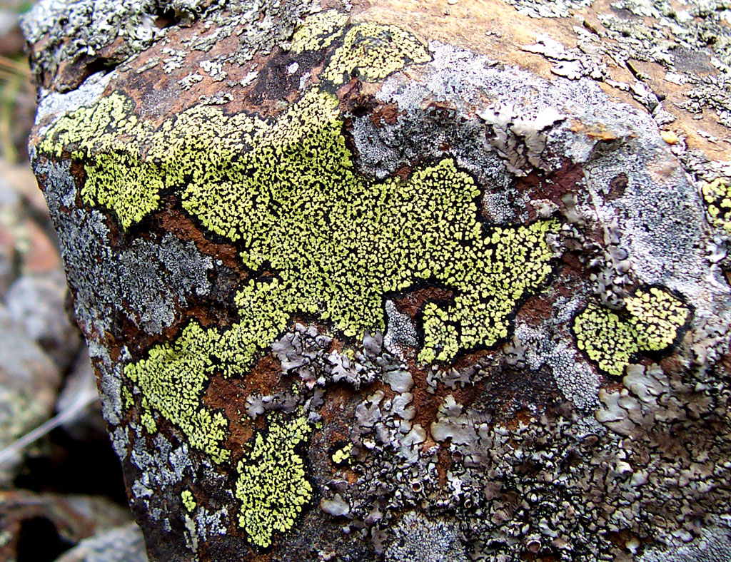
How is Soil Made?
Step 2: Pioneer species of plants can take root.
Plants change the soil chemically.
Adds organic matter when plant parts die and further break up rocks and form soils.
Notes:
Lichens and mosses are examples of pioneer species.
Once the rock is broken into smaller pieces, pioneer species of plants can take root, further changing the soil chemically, and adding organic matter when plant decompose. As pioneer species enrich the soil over the years, they improve it as a medium for plant growth, allowing the next successional stage of plants to take root.

Slide 35
How is Soil Made?
Translocation:
Various soils, like clays, organic matter, salts, etc., are translocated (moved) to deeper soil horizons (layers), and further develop the soil.
Oregon Agriculture in the Classroom
Notes:
While this is going on, chemical and physical weathering of the minerals continues.
See next slide for a picture of a soil horizon.

Slide 36
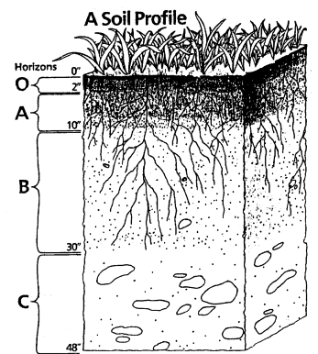
Notes:
Soil Horizons are how all these settle out.
O & A = Generally this layer of the horizon is darker colored, consisting of organic material and remnants of parent material that are more resistant to weathering. It is porous due to lower clay content and extensive burrowing by plants and animals.
B = Lighter in color and less porous than A Horizon, with accumulations of clays and oxides of iron and aluminum, transported down from the A horizon. Accumulation of clays helps retain water near the surface for use by plants.
C = Slightly weathered parent material (could be rock or unconsolidated sediment).

Slide 37
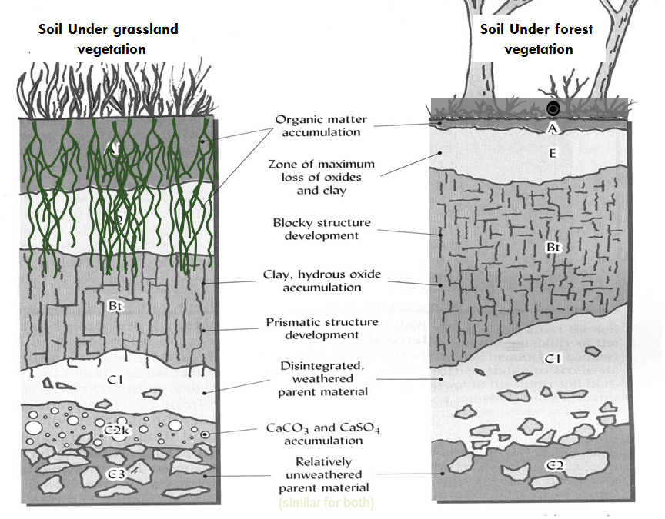
Notes:
Note that the Organic matter horizon is larger in the grassland vegetation horizon. The plants that grow on the surface can have a significant impact on the horizon below and vise versa.

Slide 38
3 Types of Rocks
Igneous -
Sedimentary -
Metamorphic -
Cooled magma (e.g., granite, basalt)
Formed from eroded materials compressed into a solid mass (e.g., limestone, sandstone, shale)
Igneous or sedimentary rock transformed by heat and pressure (e.g., marble, slate)
Igneous or sedimentary rock transformed by heat and pressure (e.g., marble, slate)
Oregon Agriculture in the Classroom
Notes:
Lessons: Three Types of Rock in Oregon and Oregon Geology Unit
Oregon is one the few states in the U.S. that has all three of these rock types. To learn more about the unique geological history of Oregon visit the Oregon Geology unit at AITC’s web site http://aitc.oregonstate.edu/lessons/geology/introduction.html.

Slide 39
Thanks to James Cassidy, at Oregon State University Soil Science Dept. for help with slides and information.
Oregon Agriculture in the Classroom

