Slide 1
Jessica Jansen, Executive Director
Brittany Capell, Education Programs Coordinator

Slide 2
Why teach agriculture?
Everyone eats, so everyone is involved in agriculture
Today’s students are far-removed from production agriculture (1% of Oregonians are farmers)
Agriculture provides an arena for real-world discovery and problem-solving

Slide 3
Quiz: Can you name a food just by seeing where it comes from?
Notes:
Broad term
Diverse kinds
Innovation for how we produce what we need

Slide 4
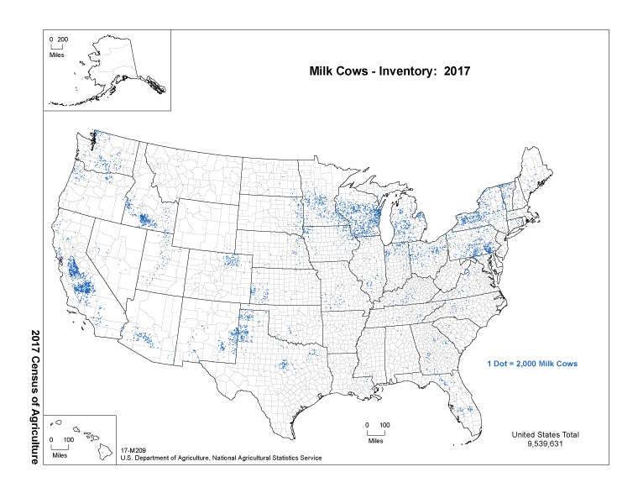
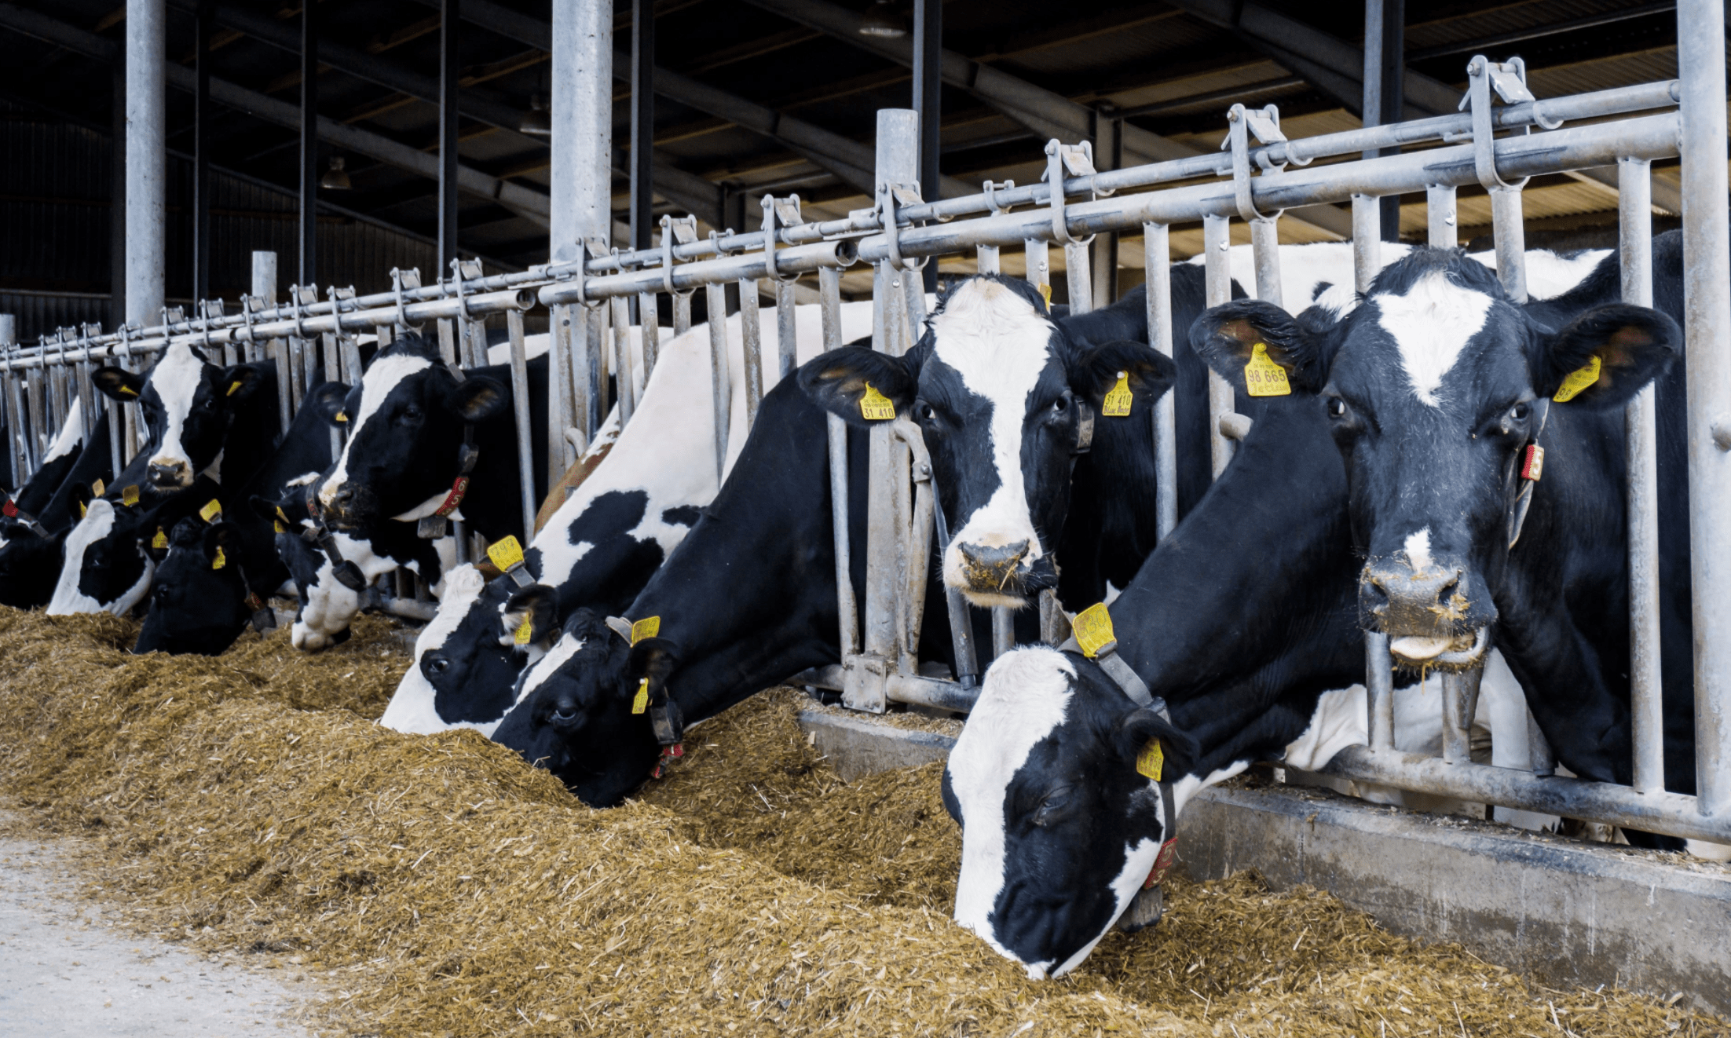
Dairy Cattle
c
c
Notes:
Source: https://www.nass.usda.gov/Publications/AgCensus/2017/Online_Resources/Ag_Atlas_Maps/

Slide 5
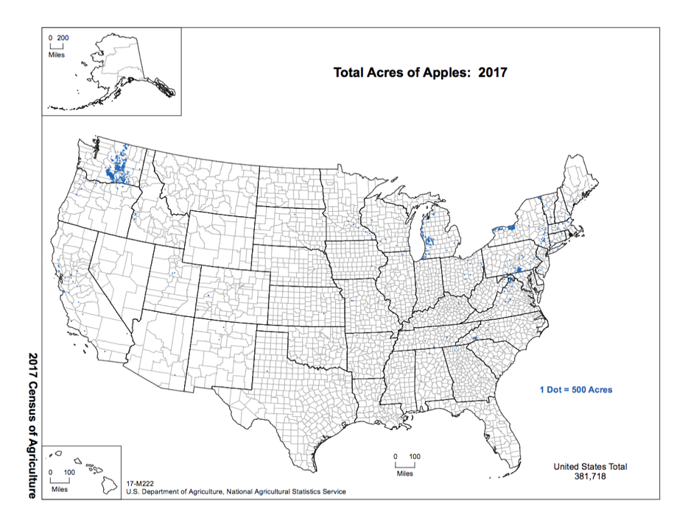
Apples
Notes:
Source: https://www.nass.usda.gov/Publications/AgCensus/2017/Online_Resources/Ag_Atlas_Maps/

Slide 6
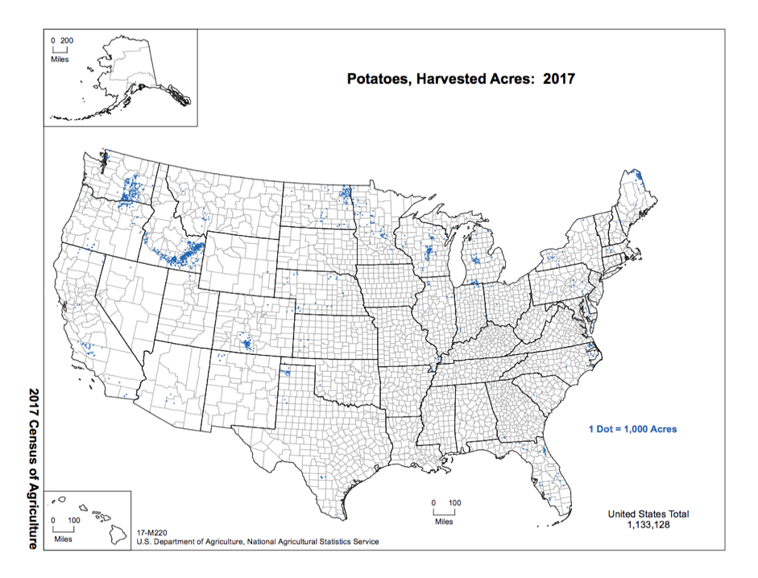
Potatoes
Notes:
Source: https://www.nass.usda.gov/Publications/AgCensus/2017/Online_Resources/Ag_Atlas_Maps/

Slide 7
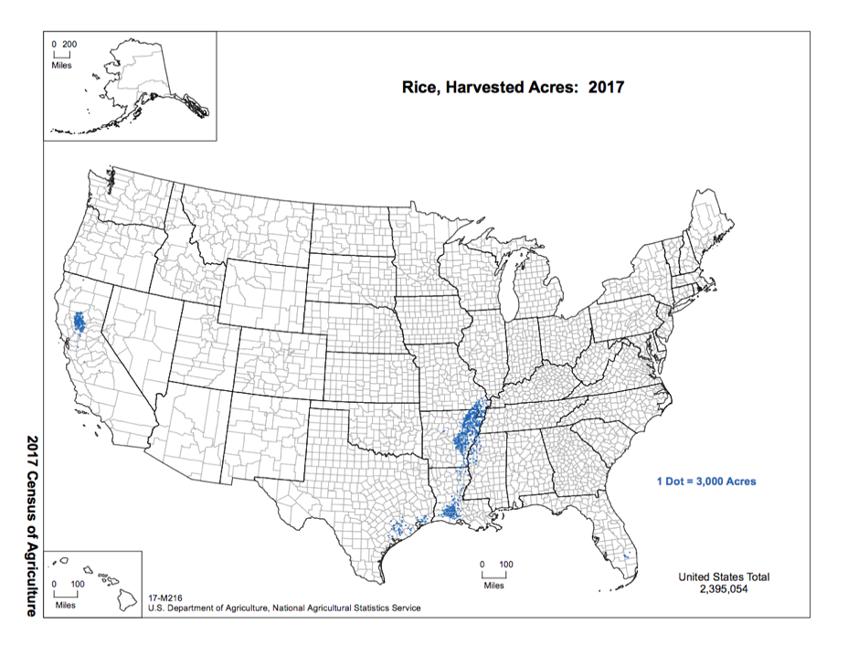
Rice
Notes:
Source: https://www.nass.usda.gov/Publications/AgCensus/2017/Online_Resources/Ag_Atlas_Maps/

Slide 8
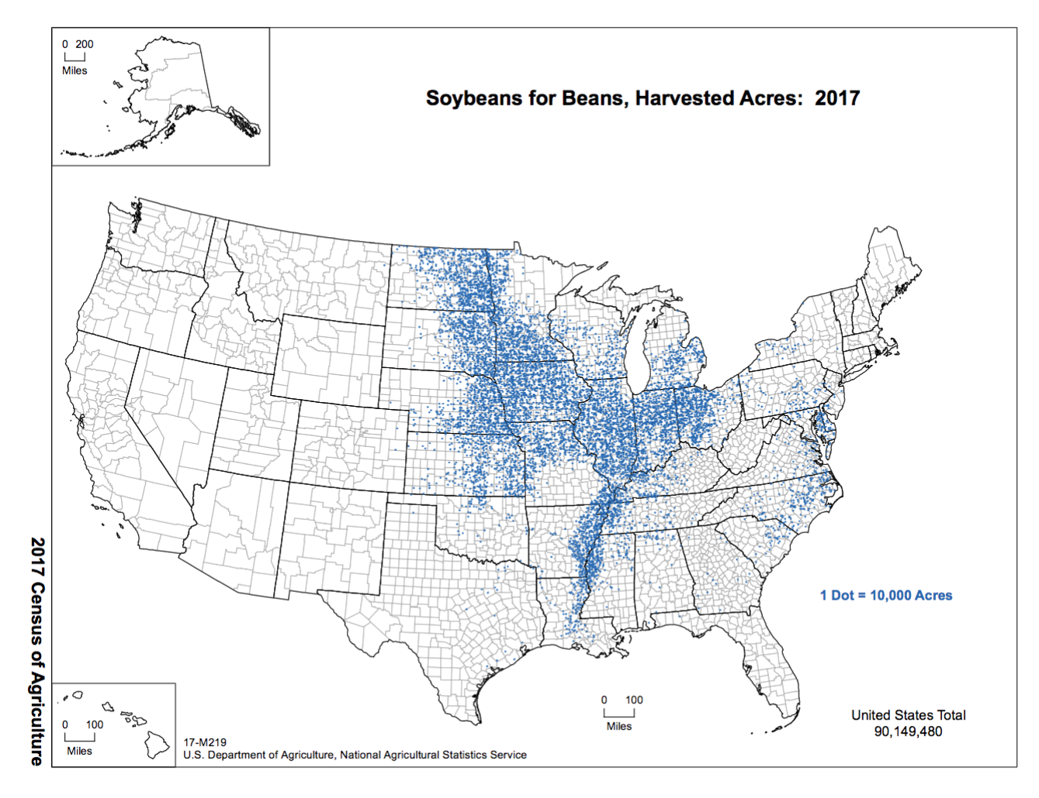
Soybeans
Notes:
Source: https://www.nass.usda.gov/Publications/AgCensus/2017/Online_Resources/Ag_Atlas_Maps/

Slide 9
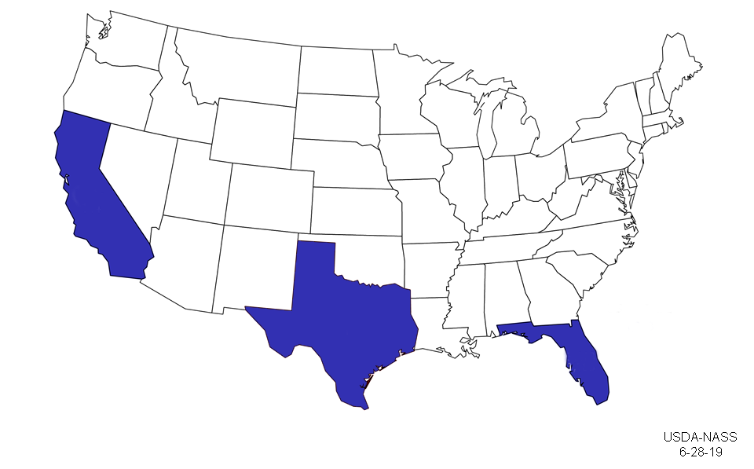
Oranges
Notes:
Source: https://www.nass.usda.gov/Charts_and_Maps/graphics/orgmap.png

Slide 10
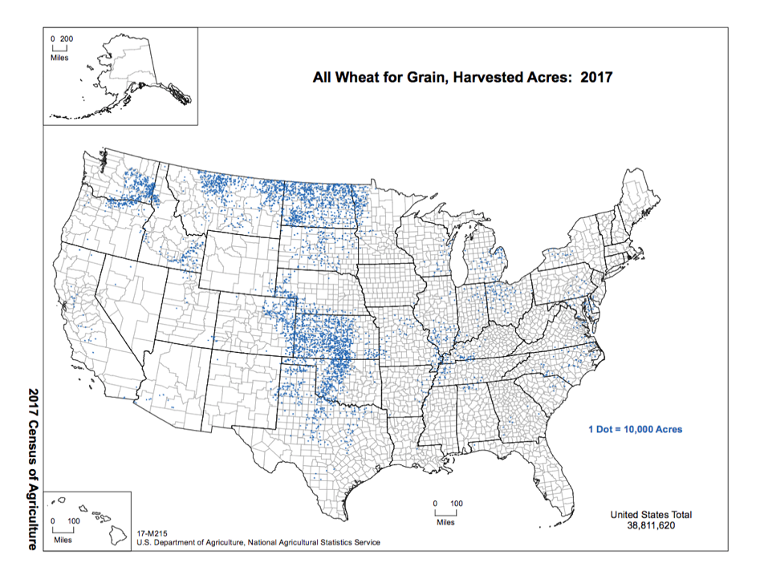
Wheat
Fun Fact:
This region is known as the “Breadbasket” due to its rich soil and ideal climate for the production of grain
Notes:
Source: https://www.nass.usda.gov/Publications/AgCensus/2017/Online_Resources/Ag_Atlas_Maps/

Slide 11
Are all crops grown in all 50 states?

Slide 12
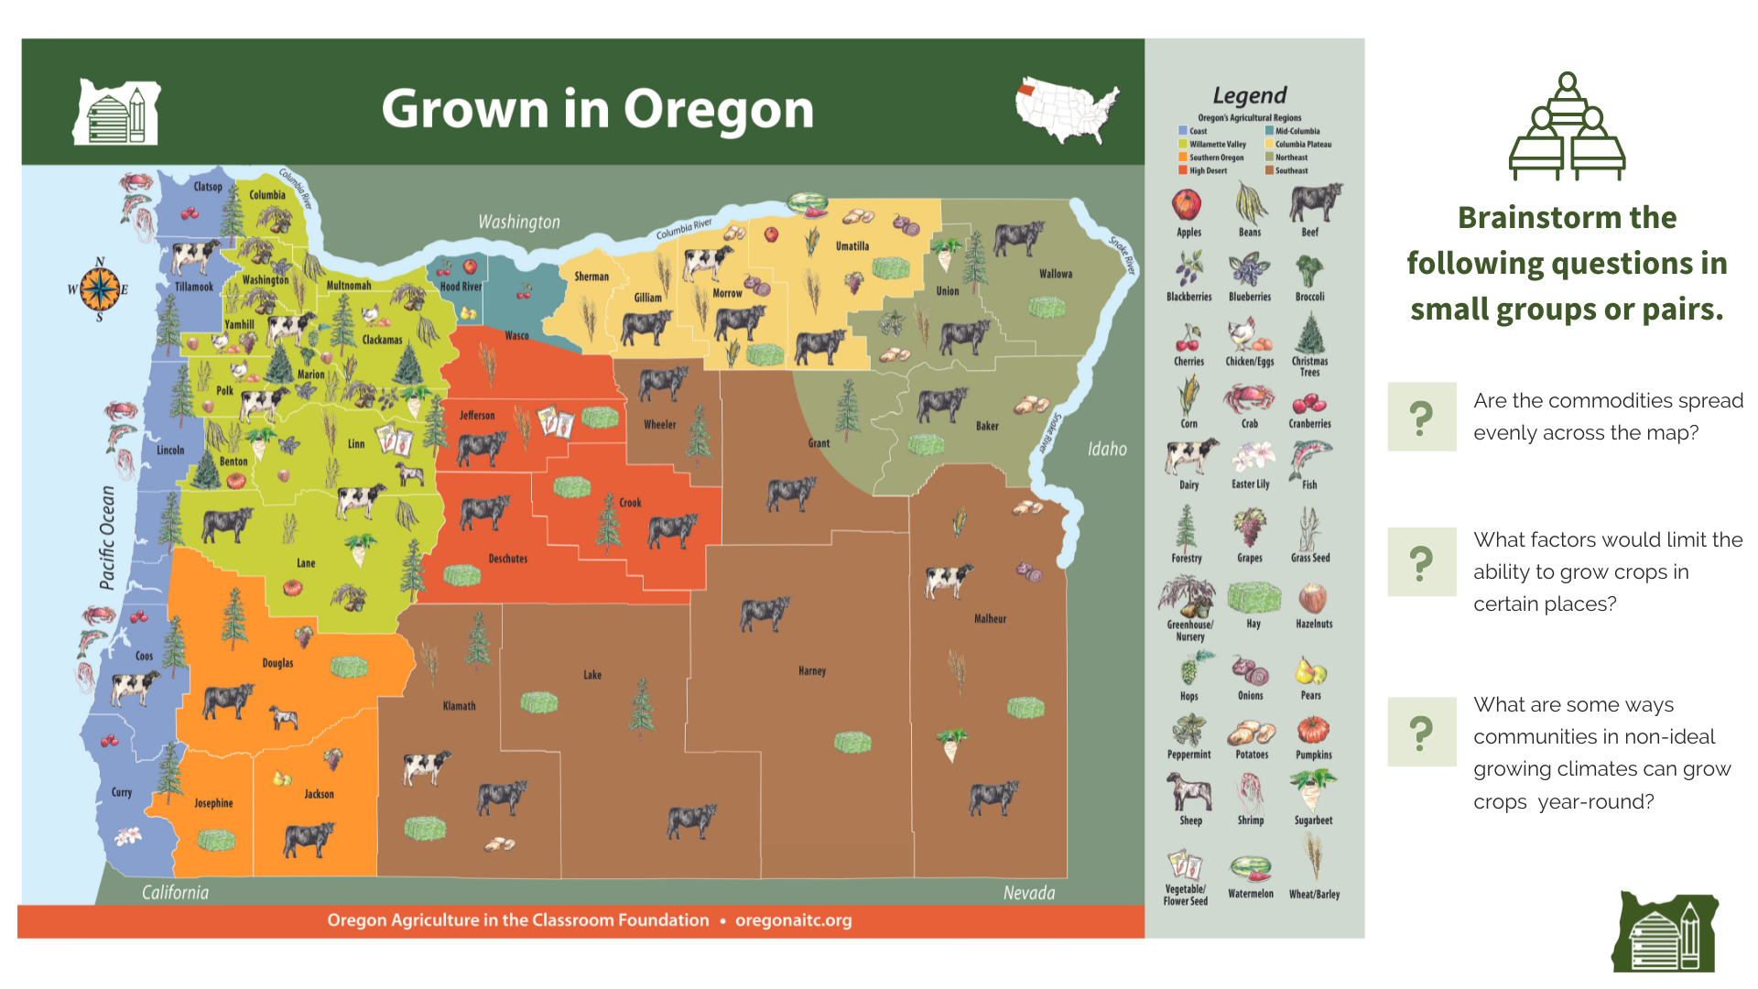

Slide 13
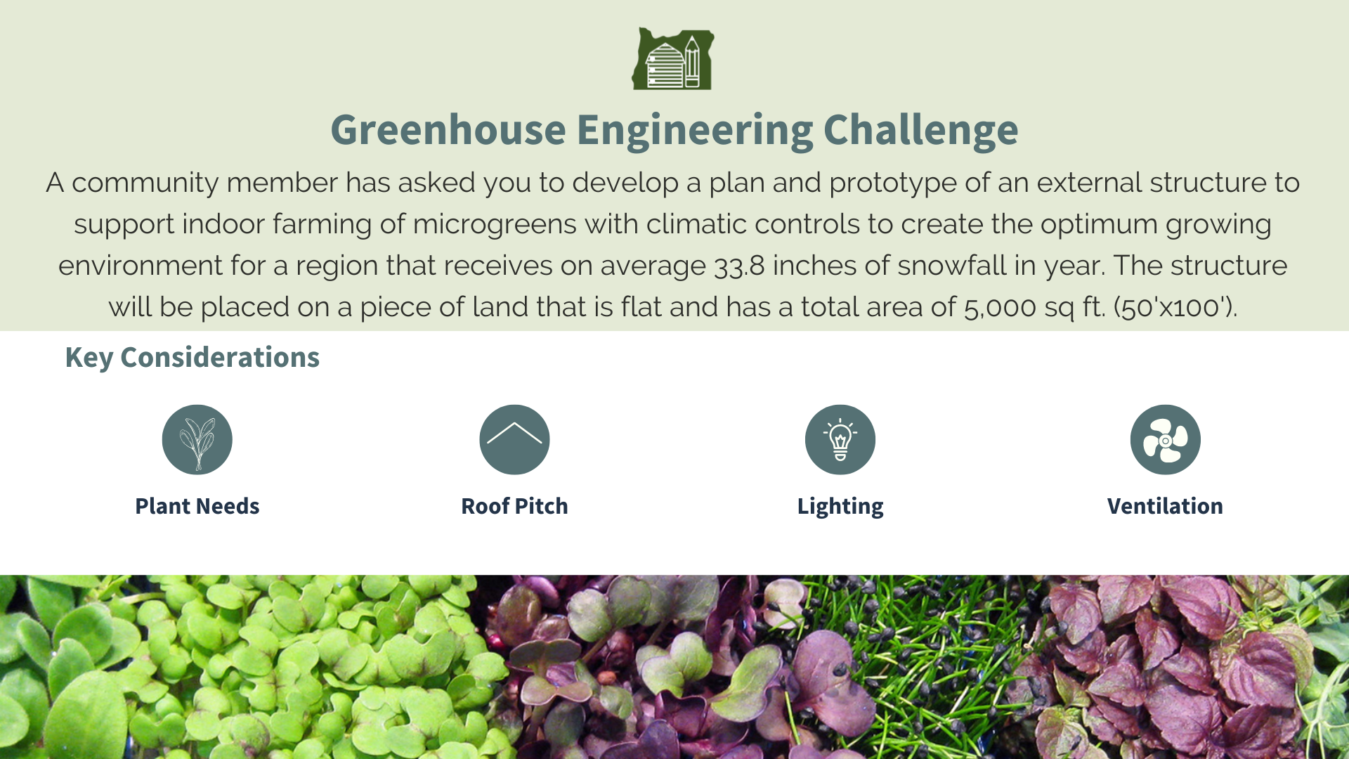

Slide 14
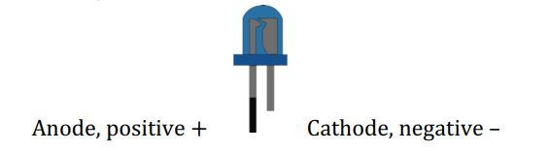
Introduction to Circuits
Current flows from the anode to the cathode

Slide 15
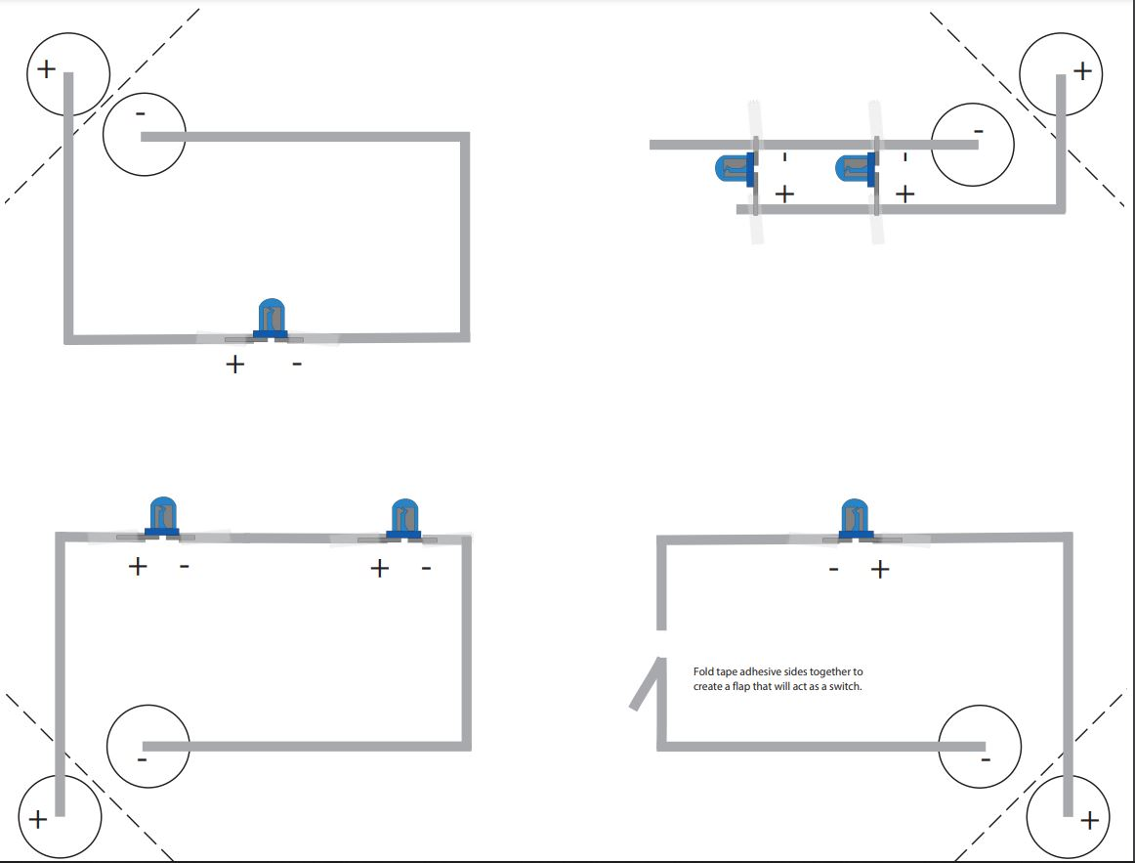
Exploring Circuit Types

Slide 16
Closed Circuit A closed circuit is a complete circuit that allows current to flow.
Open Circuit An open circuit is a broken circuit. Current cannot flow through the circuit until it's closed with a switch. Create a switch that will close the open circuit.

Slide 17
Series Circuit A series circuit is a complete circuit in which the same current flows through all circuit components.
Parallel Circuit A parallel circuit is a complete circuit in which the current flows through multiple paths to the components of the circuit.

Slide 18
Engineer a Greenhouse
With a partner, create a greenhouse using the following materials.
Each group will receive:
6x4x4 box
6 lights
Copper tape
Clear tape
Scissors
Batteries

Slide 19
Break

Slide 20
Lesson Exploration Groups
3 rounds, 10 minute stations
Maximum of 4 people per station
At each station:
Complete the activity on the Activity Summary page
Review the complete lesson plan
Discuss how it can be used in your classroom

Slide 21
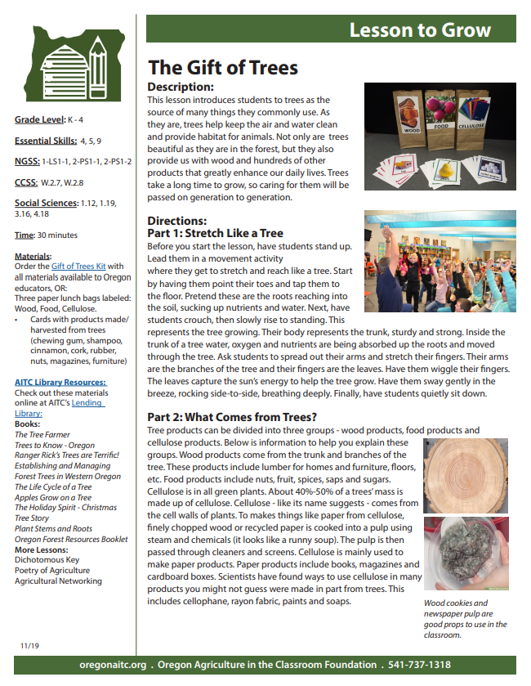
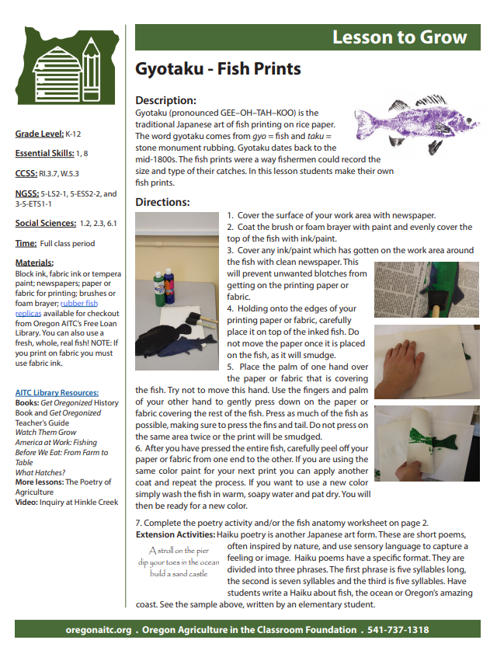
Oregon AITC Programs
Lesson Plans
Downloadable PDF files!
Notes:
For all teachers that are registered on our website, our lessons are easily downloadable and provide grade level, time, materials, and NGSS and CCSS, math, social sciences standards alignment.

Slide 22
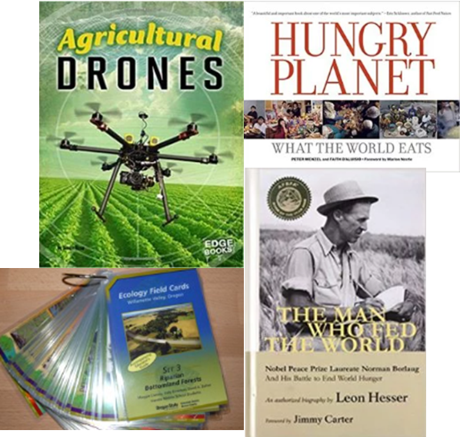
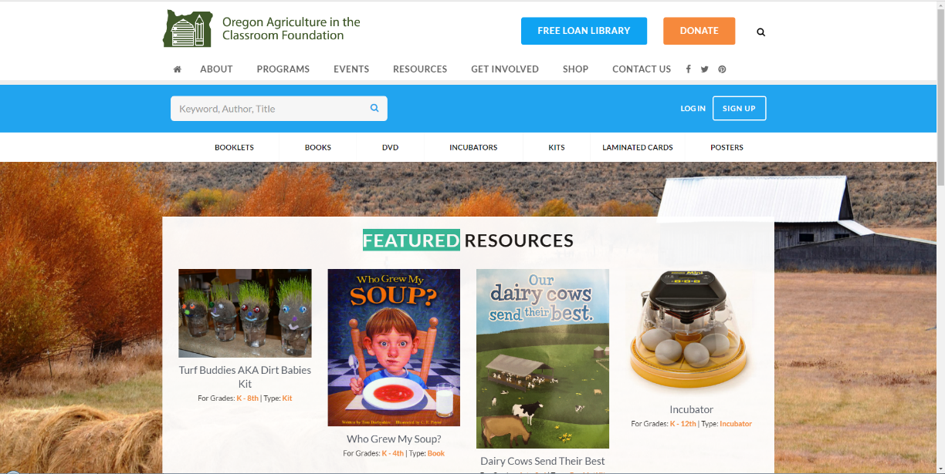
Oregon AITC Programs
Lending Library
*These items need returned
Notes:
This is a unique attribute to Oregon AITC: the Free Loan Library. We have 420+ books, videos, resources for educators to borrow for free in the state. You may create an account, check out resources, and pay for return mailing. 3 weeks is the borrowing time, but you can request longer time.

Slide 23
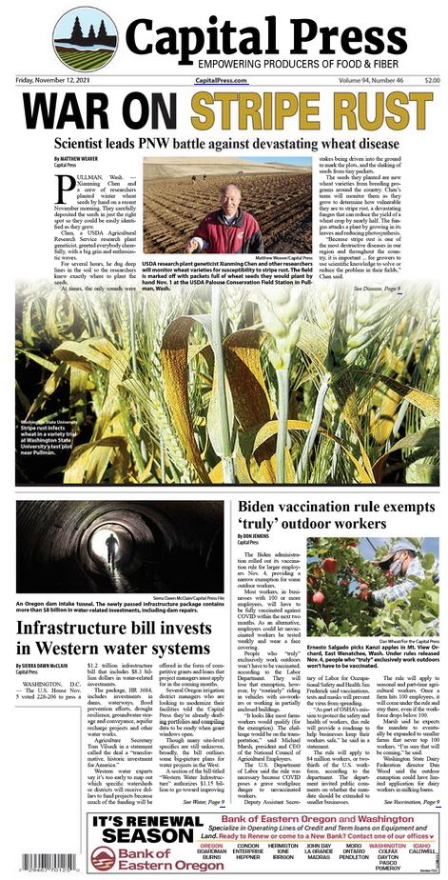
Current Events in Agriculture

Slide 24
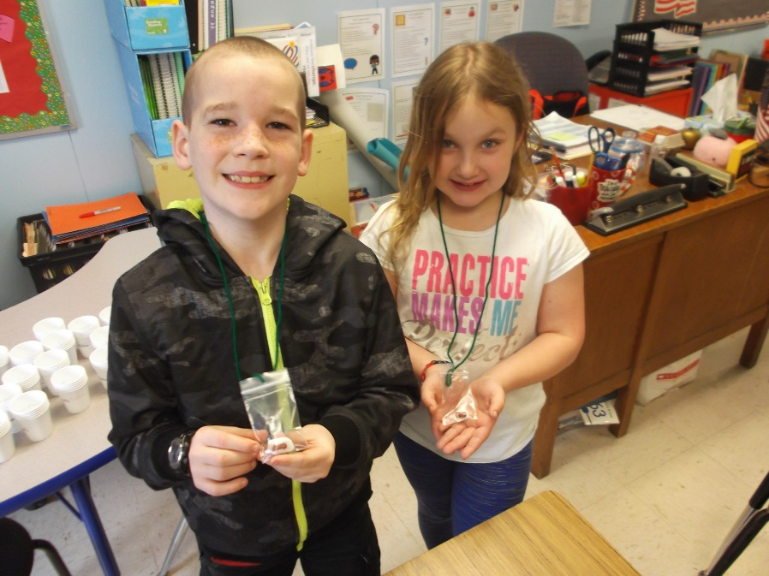
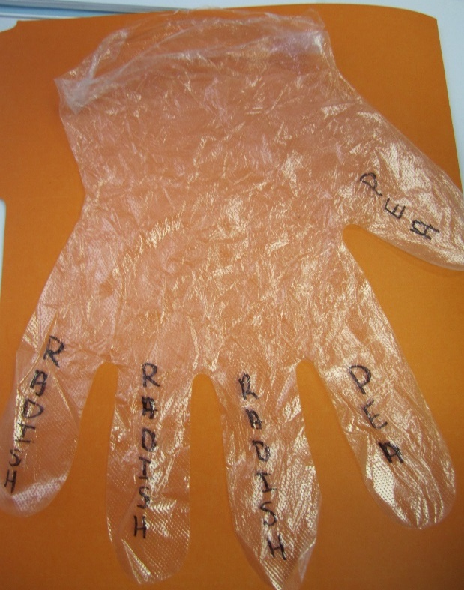
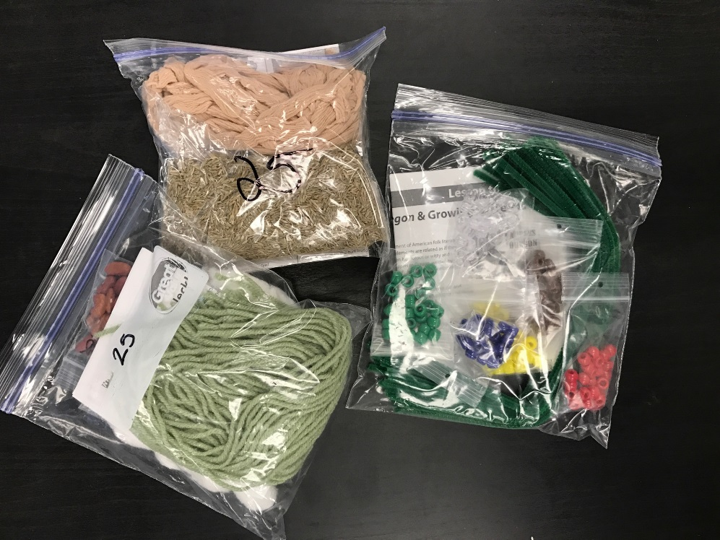
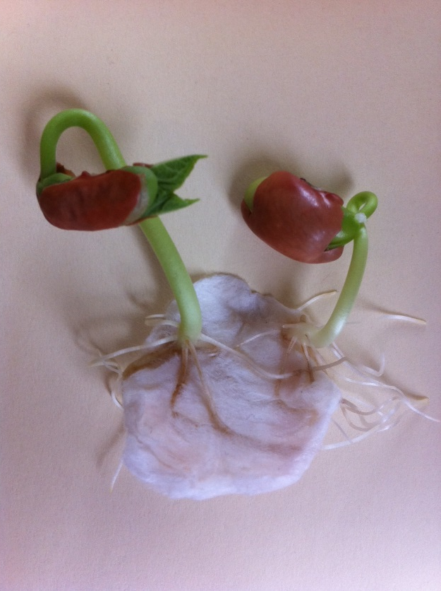
Oregon AITC Programs
Kits
*These items do NOT need returned *Orders will take up to two weeks to be processed
Notes:
Kits are free, helpful materials for lessons. They would not be possible without our volunteers from OSU that help us put them together with their service hours. Living necklaces, cups for Seed Soil Sun, Busy Bees pollinator kit with chalk, etc.

Slide 25
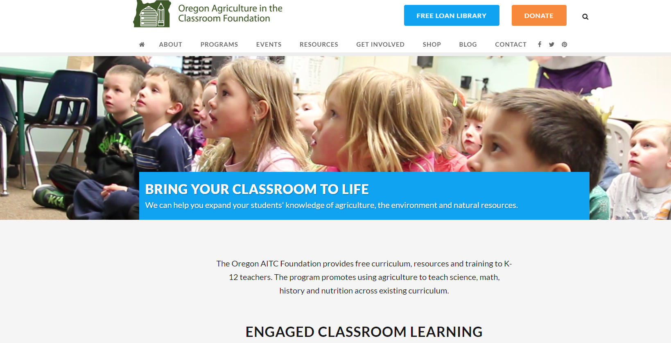
Website Tour
www.oregonaitc.org

Slide 26
Teacher Kit
Materials for the following lessons:
Increasing Production with Precision Agriculture
Greenhouse Engineering Challenge
An Appetizer for Astronauts
$ Gift Certificate to NAITCO Store

Slide 27
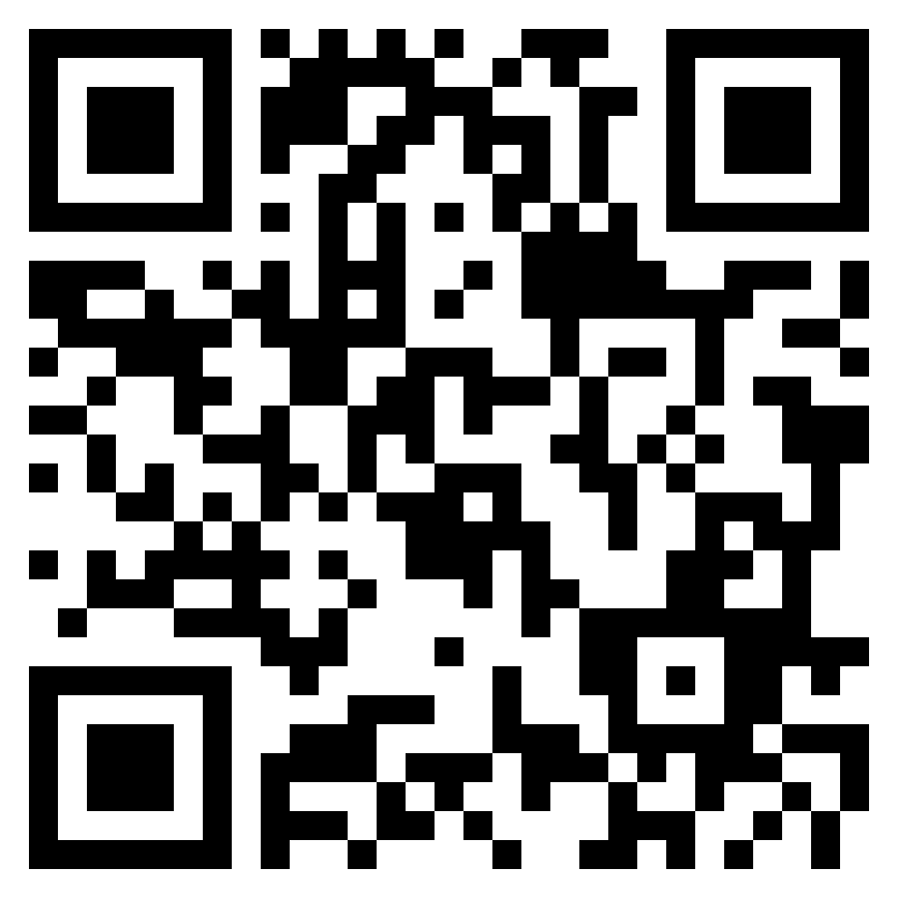
Evaluation
naitco.jotform.com/231925687735974

Slide 28
Jessica Jansen, Executive Director Jessica.Jansen@oregonstate.edu Brittany Capell, Education Programs Coordinator Brittany.Capell@oregonstate.edu

