Slide 1
Jessica Jansen, Executive Director Casey Blake, Washington County Programs Coordinator

Slide 2
Workshop Overview
What is Oregon Agriculture in the Classroom?
What is agriculture?
Why teach agriculture?
How can I use agriculture in my classroom?

Slide 3
Program Information
Mission
To help students grow in their knowledge of agriculture, the environment and natural resources for the benefit of Oregonians today and in the future.
Overview
Agriculture is used as a context to teach core subject standards
Cross-curricular hands on materials and lessons geared towards core standards for all educators
K-12, public, private, homeschool, afterschool, extracurricular, in all 36 counties of Oregon
Supported by agricultural community

Slide 4
Source Relay

Slide 5
What is agriculture?
Notes:
Broad term
Diverse kinds
Innovation for how we produce what we need

Slide 6
Agriculture is……
“The science, art or practice of cultivating the soil, producing crops, and raising livestock and in varying degrees preparation and marketing of the resulting products.”

Slide 7
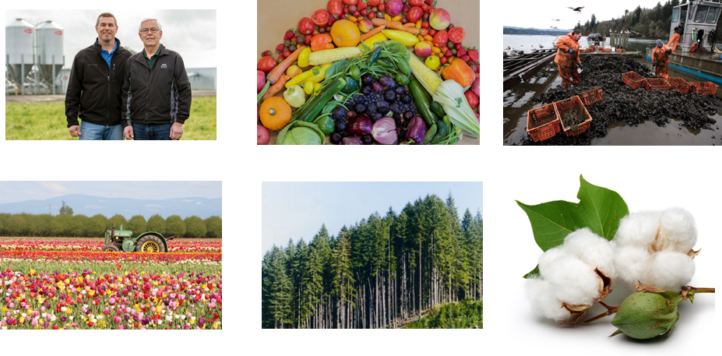
6 F’s of Agriculture
Farming
Food
Fiber
Forestry
Fishing
Flowers

Slide 8
Can you name an agricultural product just by seeing where it is grown?

Slide 9
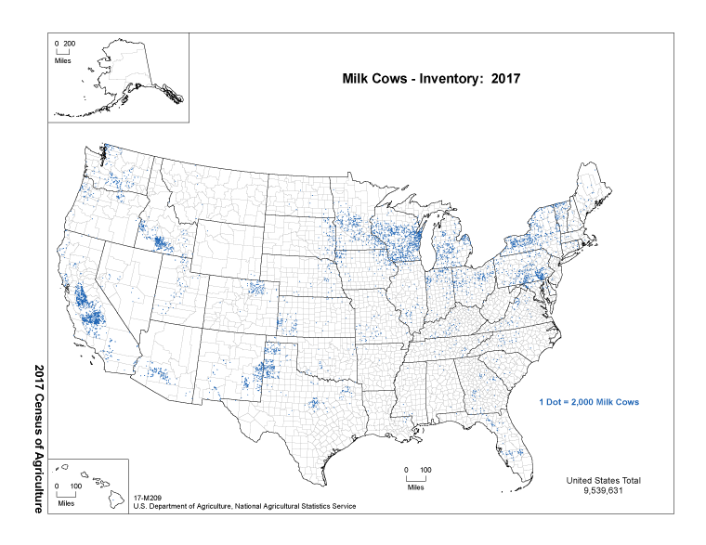
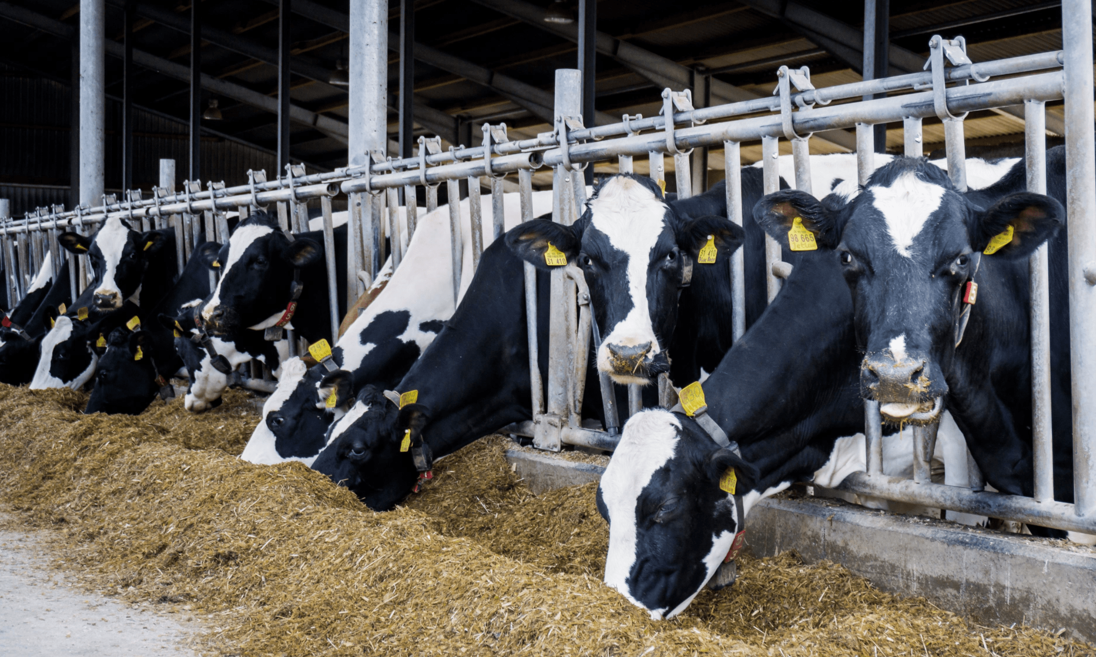
Dairy Cattle
c
c
Notes:
Source: https://www.nass.usda.gov/Publications/AgCensus/2017/Online_Resources/Ag_Atlas_Maps/

Slide 10
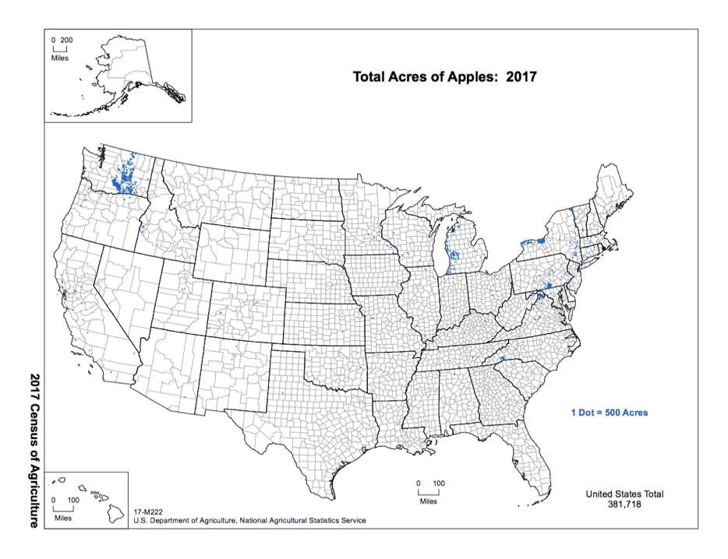
Apples
Notes:
Source: https://www.nass.usda.gov/Publications/AgCensus/2017/Online_Resources/Ag_Atlas_Maps/

Slide 11
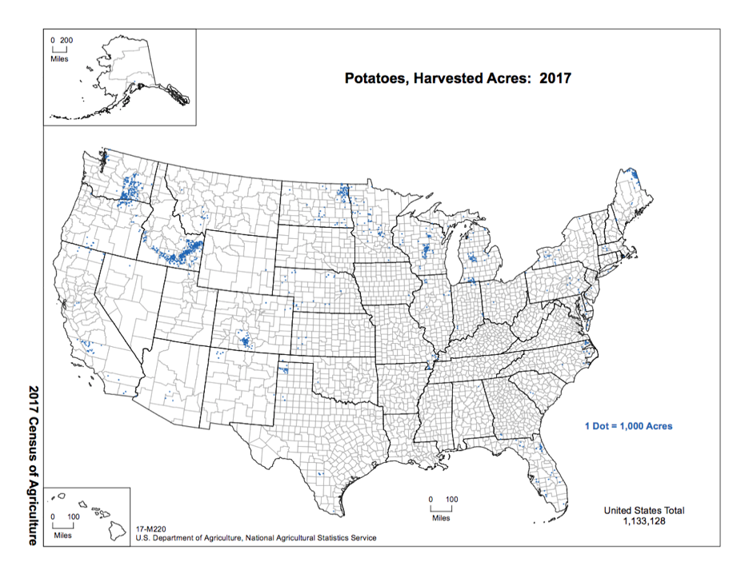
Potatoes
Notes:
Source: https://www.nass.usda.gov/Publications/AgCensus/2017/Online_Resources/Ag_Atlas_Maps/

Slide 12
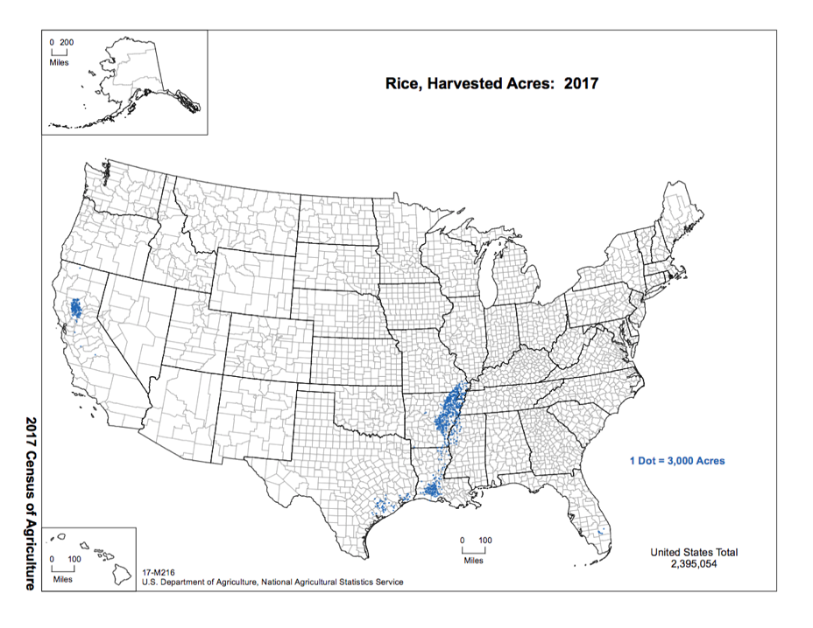
Rice
Notes:
Source: https://www.nass.usda.gov/Publications/AgCensus/2017/Online_Resources/Ag_Atlas_Maps/

Slide 13
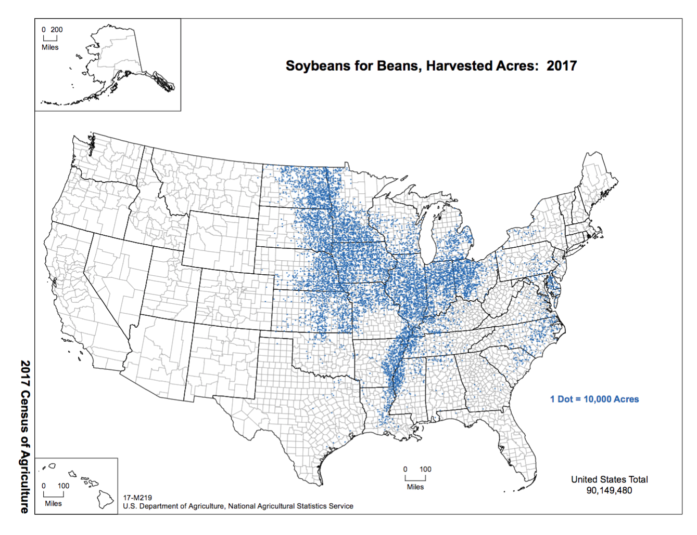
Soybeans
Notes:
Source: https://www.nass.usda.gov/Publications/AgCensus/2017/Online_Resources/Ag_Atlas_Maps/

Slide 14
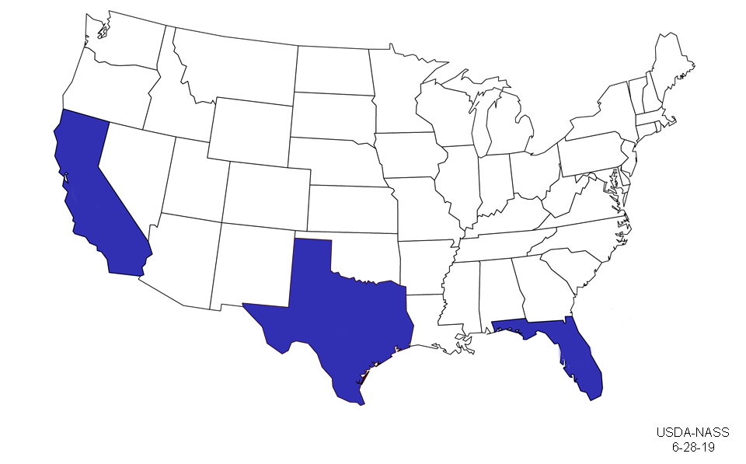
Oranges
Notes:
Source: https://www.nass.usda.gov/Charts_and_Maps/graphics/orgmap.png

Slide 15
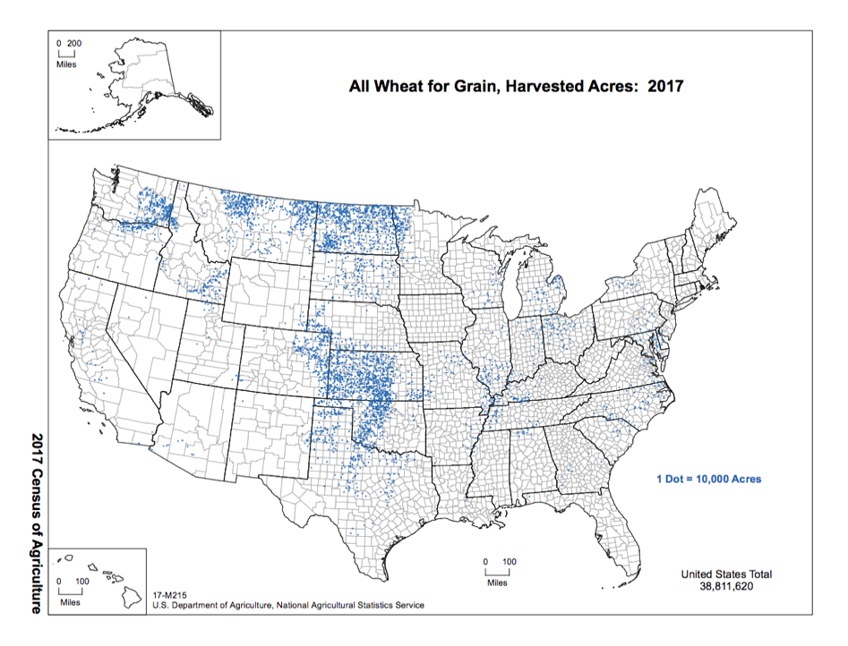
Wheat
Fun Fact:
This region is known as the “Breadbasket” due to its rich soil and ideal climate for the production of grain
Notes:
Source: https://www.nass.usda.gov/Publications/AgCensus/2017/Online_Resources/Ag_Atlas_Maps/

Slide 16
Are all crops grown in all 50 states?

Slide 17
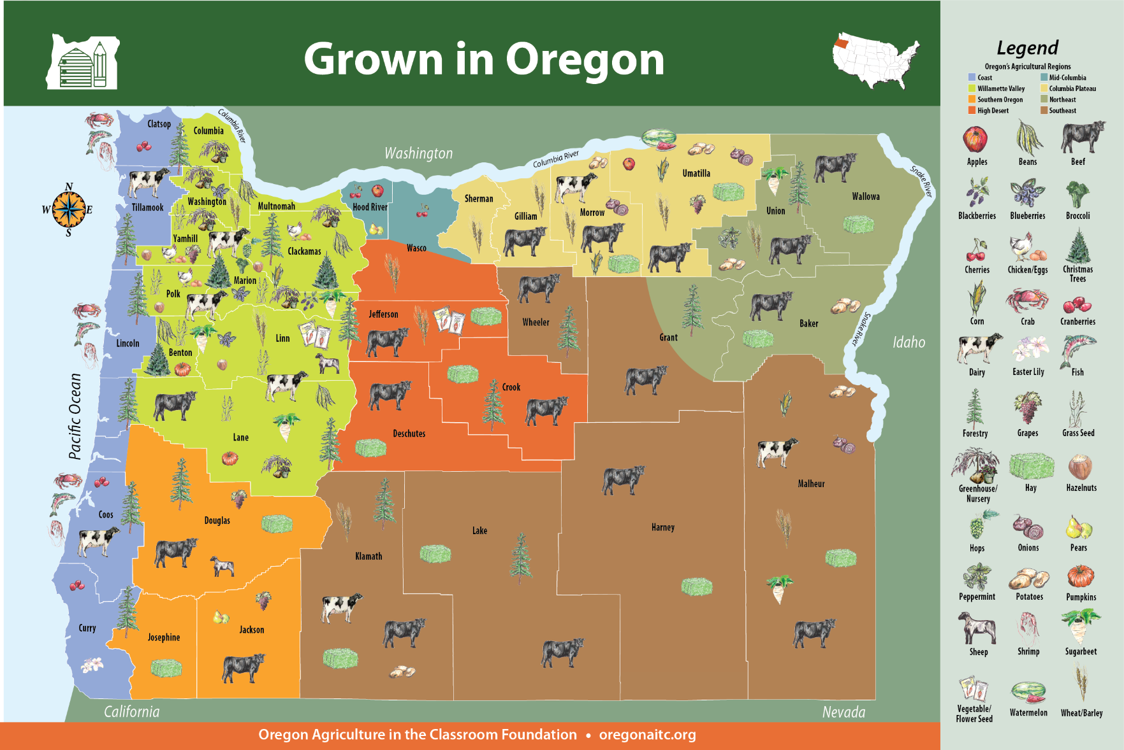
Oregon Agriculture
* 220+ Agricultural Commodities * Several Diverse Growing regions
Top 10 Commodities
Greenhouse & Nursery
Cattle & Calves
Hay
Milk
Grass Seed
Wheat
Potatoes
Grapes for wine
Cherries
Hazelnuts
Average age of principal operator is 57.9.
97% of farms are family owned
Notes:
Oregon is one of the most diverse states with so many opportunities for careers and growth in agricultural sectors.

Slide 18
Why teach agriculture?
Everyone eats, so everyone is involved in agriculture
Today’s students are far-removed from production agriculture (1% of Oregonians are farmers)
Agriculture provides an arena for real-world discovery and problem-solving

Slide 19
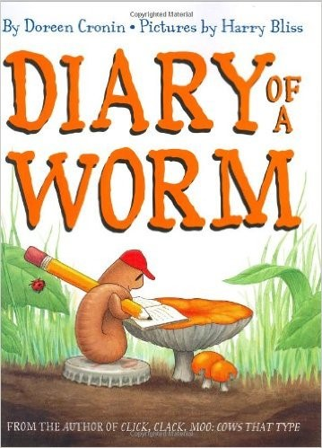
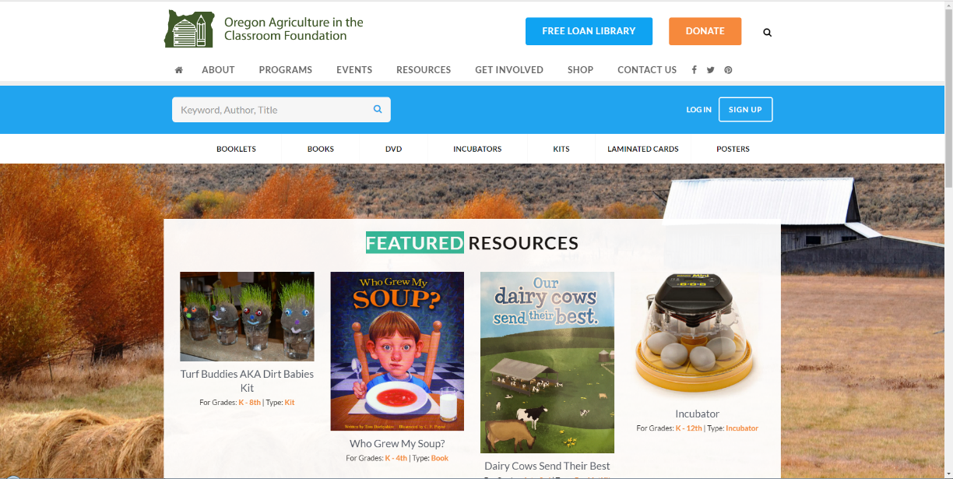
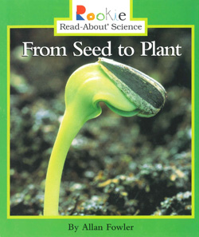
Oregon AITC Programs
Lending Library
*These items need returned
Notes:
This is a unique attribute to Oregon AITC: the Free Loan Library. We have 420+ books, videos, resources for educators to borrow for free in the state. You may create an account, check out resources, and pay for return mailing. 3 weeks is the borrowing time, but you can request longer time.

Slide 20
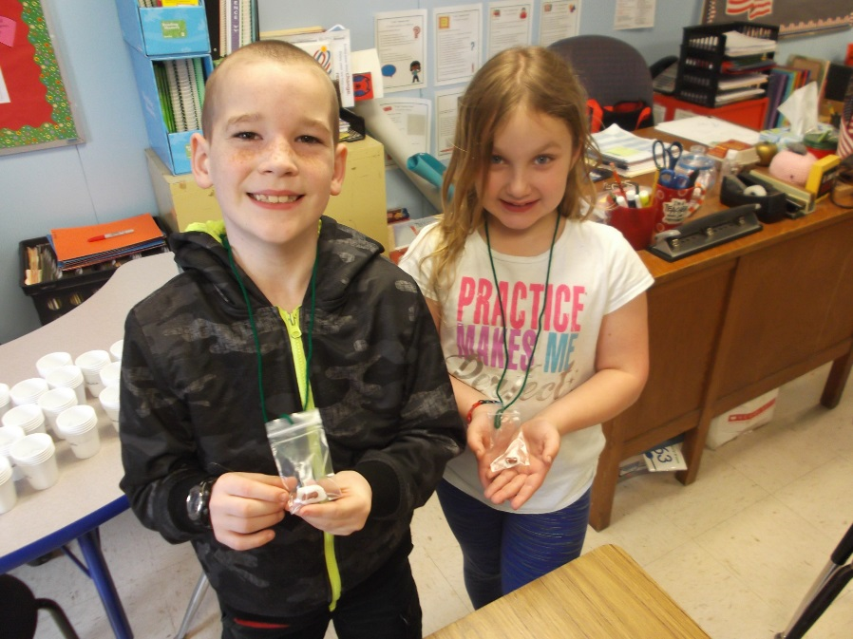
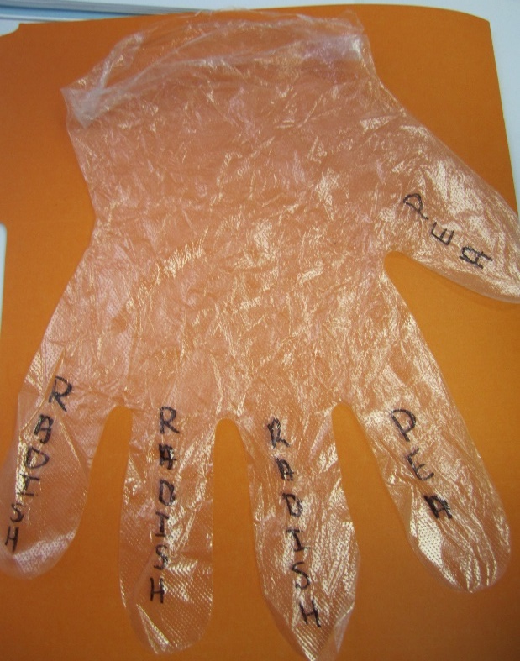
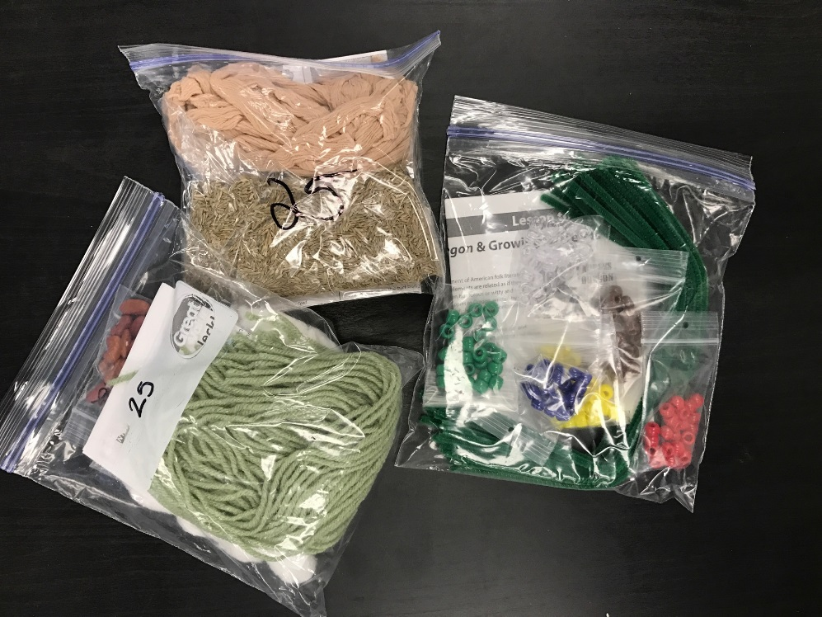
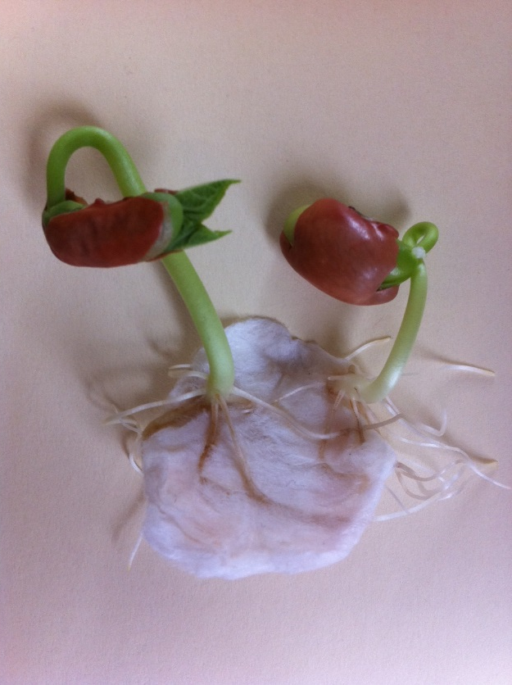
Oregon AITC Programs
Kits
*These items do NOT need returned
Notes:
Kits are free, helpful materials for lessons. They would not be possible without our volunteers from OSU that help us put them together with their service hours. Living necklaces, cups for Seed Soil Sun, Busy Bees pollinator kit with chalk, etc.

Slide 21
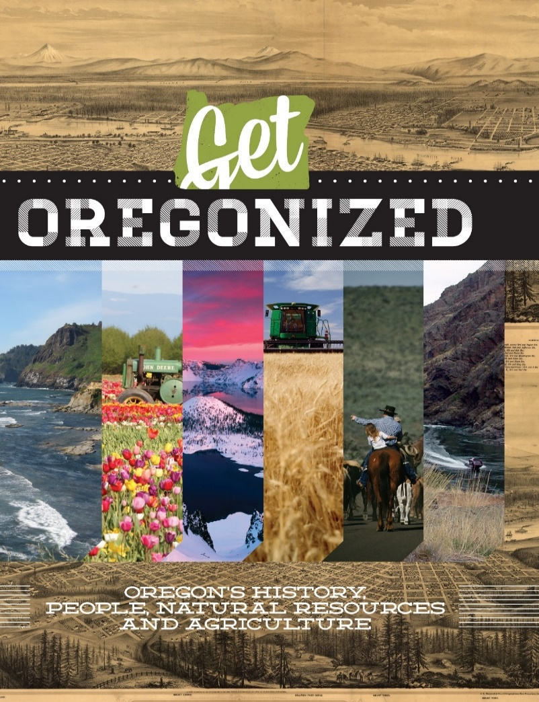
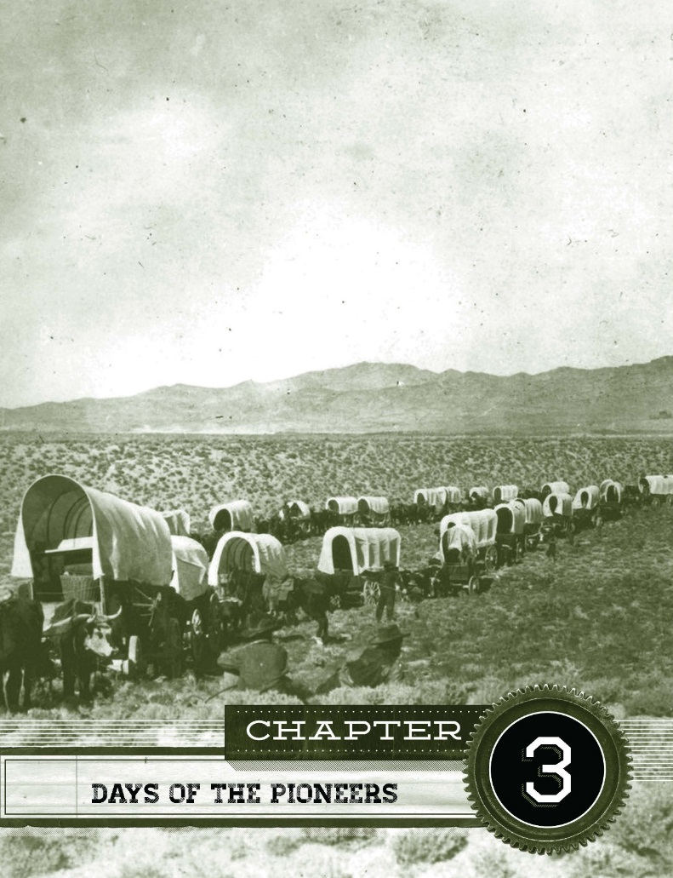
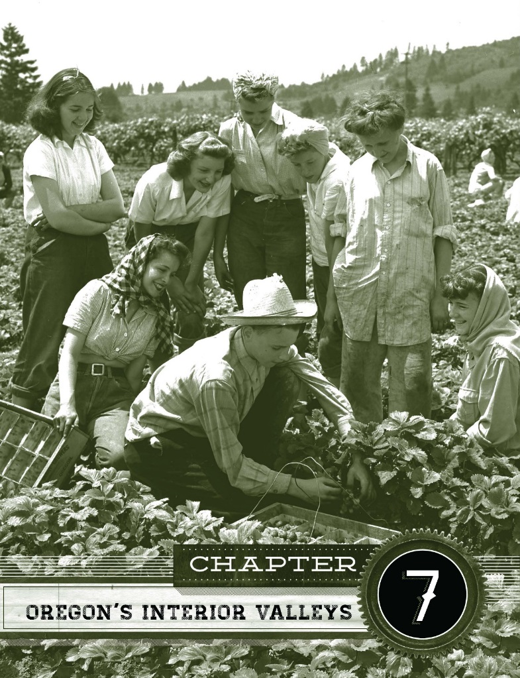
Oregon AITC Programs
Get Oregonized
Notes:
Get Oregonized is an Oregon history textbook that we have published since 1985 and it is revised every few years. It is now a beautiful book with historical images of our state and incorporates hands-on lessons. There is a teacher and student edition. They are $20 a book but we have a scholarship program – let us know if you are interested in applying.

Slide 22
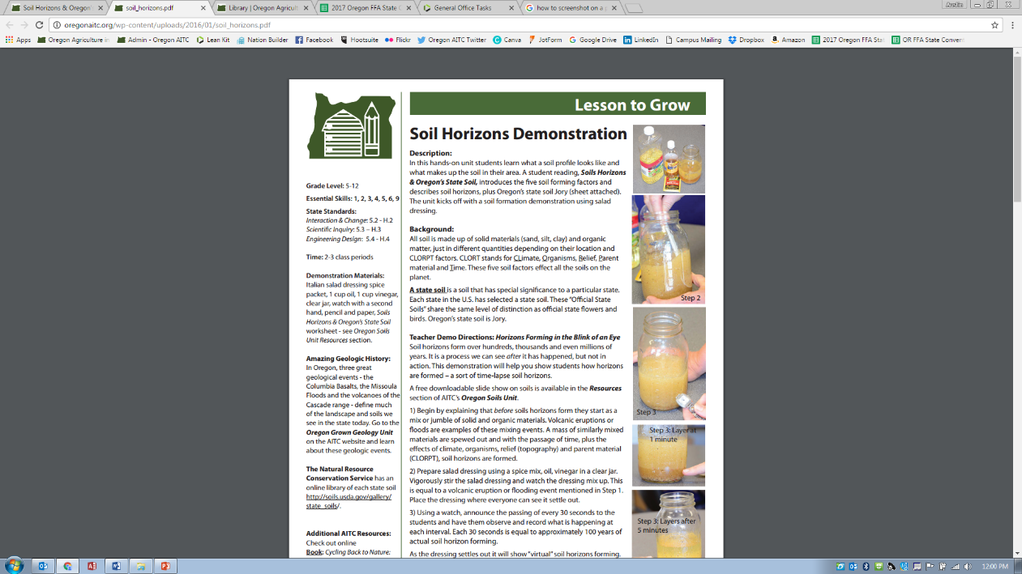
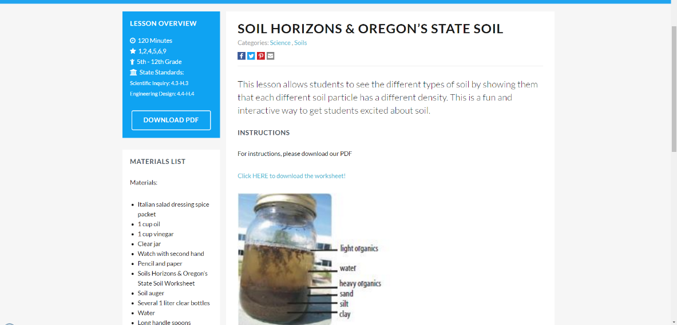
Oregon AITC Programs
Lesson Plans
Downloadable PDF files!
Notes:
For all teachers that are registered on our website, our lessons are easily downloadable and provide grade level, time, materials, and NGSS and CCSS, math, social sciences standards alignment.

Slide 23
Lesson Exploration
From Wool to Wheel
Three Sisters Garden
Agricultural Inventors
The Columbian Exchange of Old and New World Foods

Slide 24
Agriculture… where does it fit?

Slide 25
Agriculture… where does it fit?
History
Climate/Region
Past, Present and Future Developments
Trade
Sustainability
Lifecycles
Culture
Health, Safety and Nutrition
Seasons
Life Science
Geography
Traits
Oregon History
U.S. History
Consumerism
Ecosystems

Slide 26
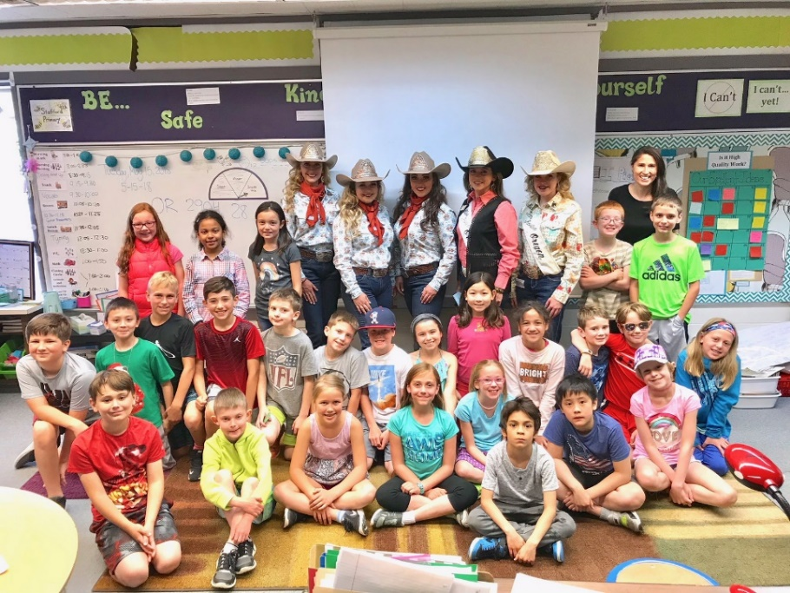
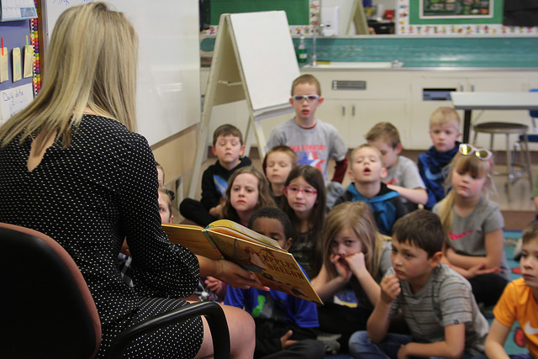
Oregon AITC Programs
Agricultural Literacy Project
Notes:
Our Annual Agricultural Literacy Project has been going on for about 12 years. The goals are both to increase awareness of where food comes from, and also improving reading skills. Each year a book is chosen to highlight one aspect of the 6 F’s of Oregon agriculture, and we develop a lesson around it. This years’ is about Temple Grandin’s perseverance in the face of adversity. Volunteers with some connection to agriculture go into classrooms, read the book, and go through the lesson with students and talk about their role in farming or forestry, etc.
We are always looking for good children’s books, so let us know if you have a favorite!

Slide 27
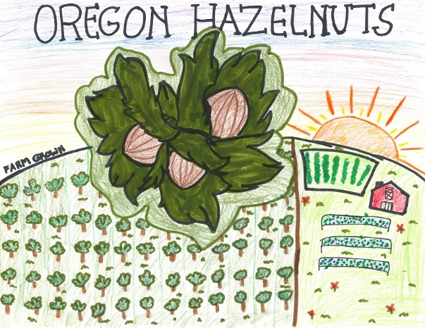
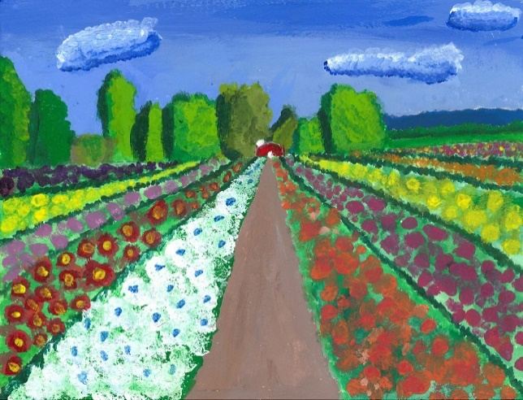
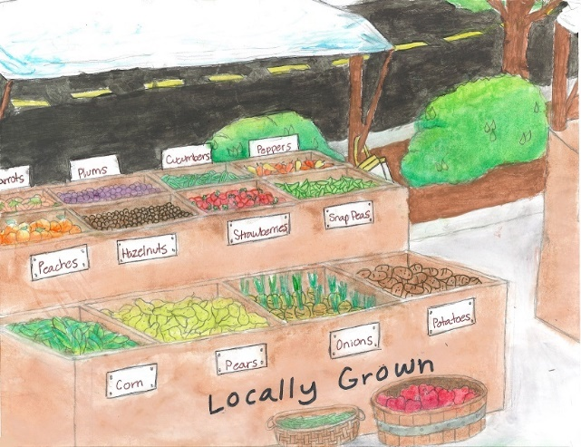
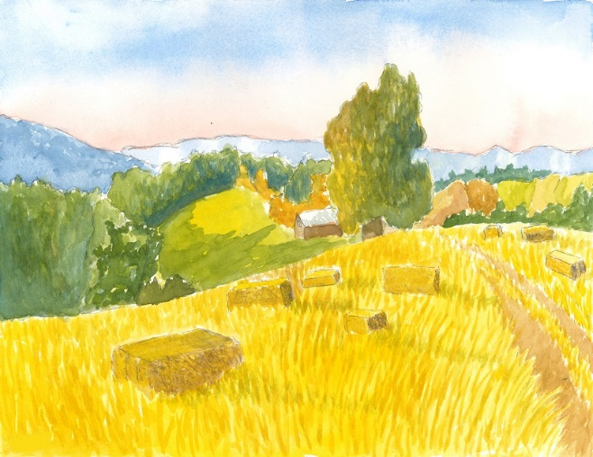
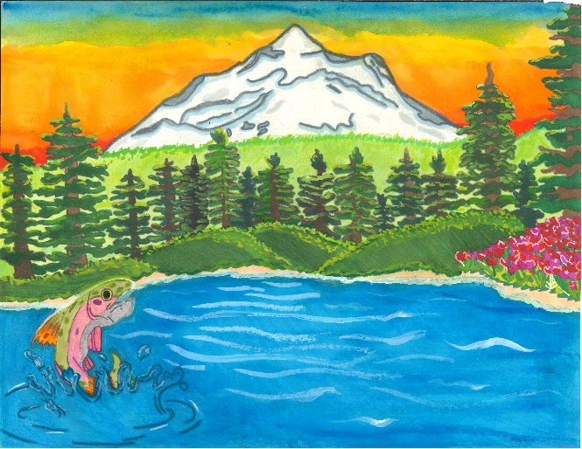
Oregon AITC Programs
Calendar Art Contest
Notes:
We want Oregon students to take pride in our state’s agricultural industry. We showcase the beauty and diversity of Oregon Ag with our annual Calendar contest. K-6th graders can submit their colorful art for a chance to win $50 and a place in our statewide calendar. Last year we received 1,754 entries so it is popular.

Slide 28
Jessica Jansen, Executive Director Jessica.Jansen@oregonstate.edu

