Slide 1


Aquaponics Workshop

Slide 2

PROGRAM INFORMATION
Mission
2013
To help students grow in their knowledge of agriculture, the environment and natural resources for the benefit of Oregonians today and in the future.
Overview
Agriculture is used as a context to teach core subject standards
Cross-curricular hands on materials and lessons geared towards core standards for all educators
K-12, public, private, homeschool, afterschool, extracurricular, in all 36 counties of Oregon
Supported by agricultural community

Slide 3

What is Aquaponics?
Aquaponics Video

Slide 4

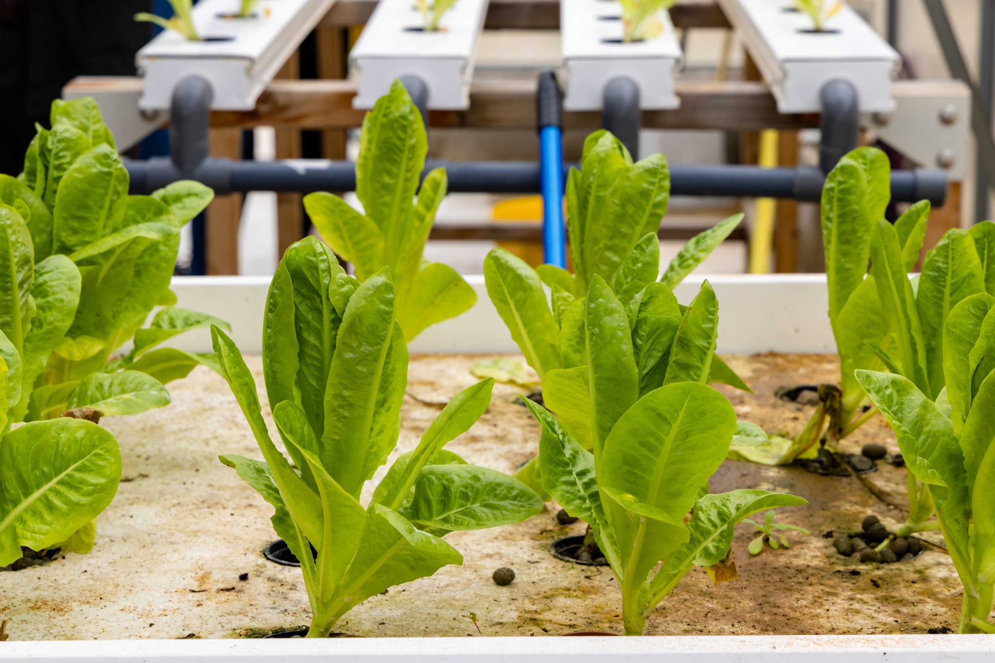
What is Aquaponics?
Recirculating biological and mechanical system of edible plants and fish.
Aquaponics was developed as an integrated method of raising fish and vegetables

Slide 5
Why would it be beneficial to raise fish and plants in the same system?

Slide 6
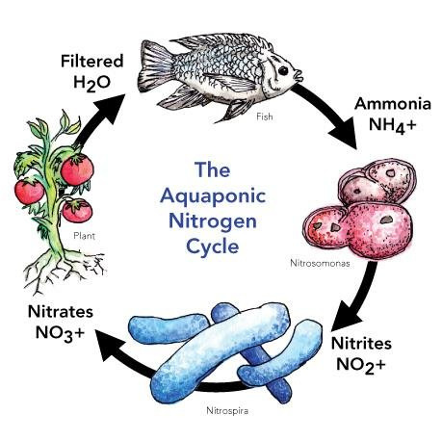
THE AQUAPONICS CYCLE
FISH FOOD (PROTEINS) AND FISH METABOLISM NATURALLY ADD NITROGEN TO THE SYSTEM.
UNEATEN FOOD AND FISH WASTE ARE CONVERTED INTO AMMONIA (NH3/NH4)
NITROSOMONAS (BACTERIA) CONVERTS TO NO2, NITRITE → NITROBACTER (BACTERIA) CONVERTS TO NO3 NITRATE.
PLANT ROOTS STRIP N2 FOR UPTAKE USED METABOLICALLY, PRIMARILY FOR GROWTH.

Slide 7
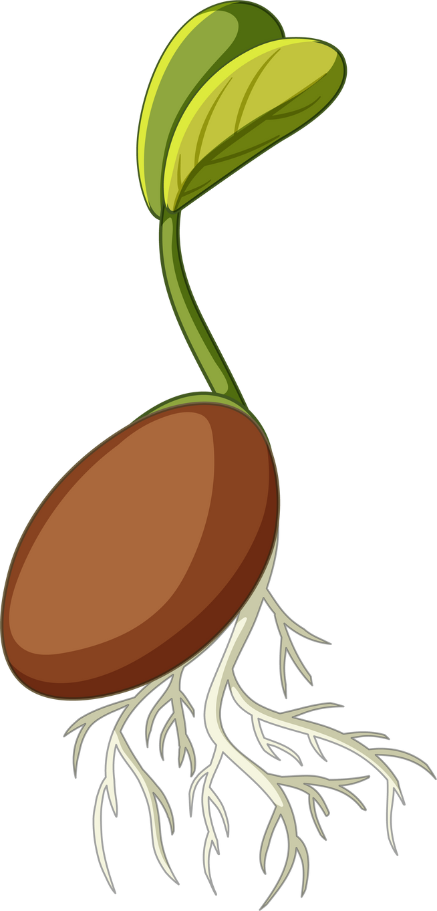


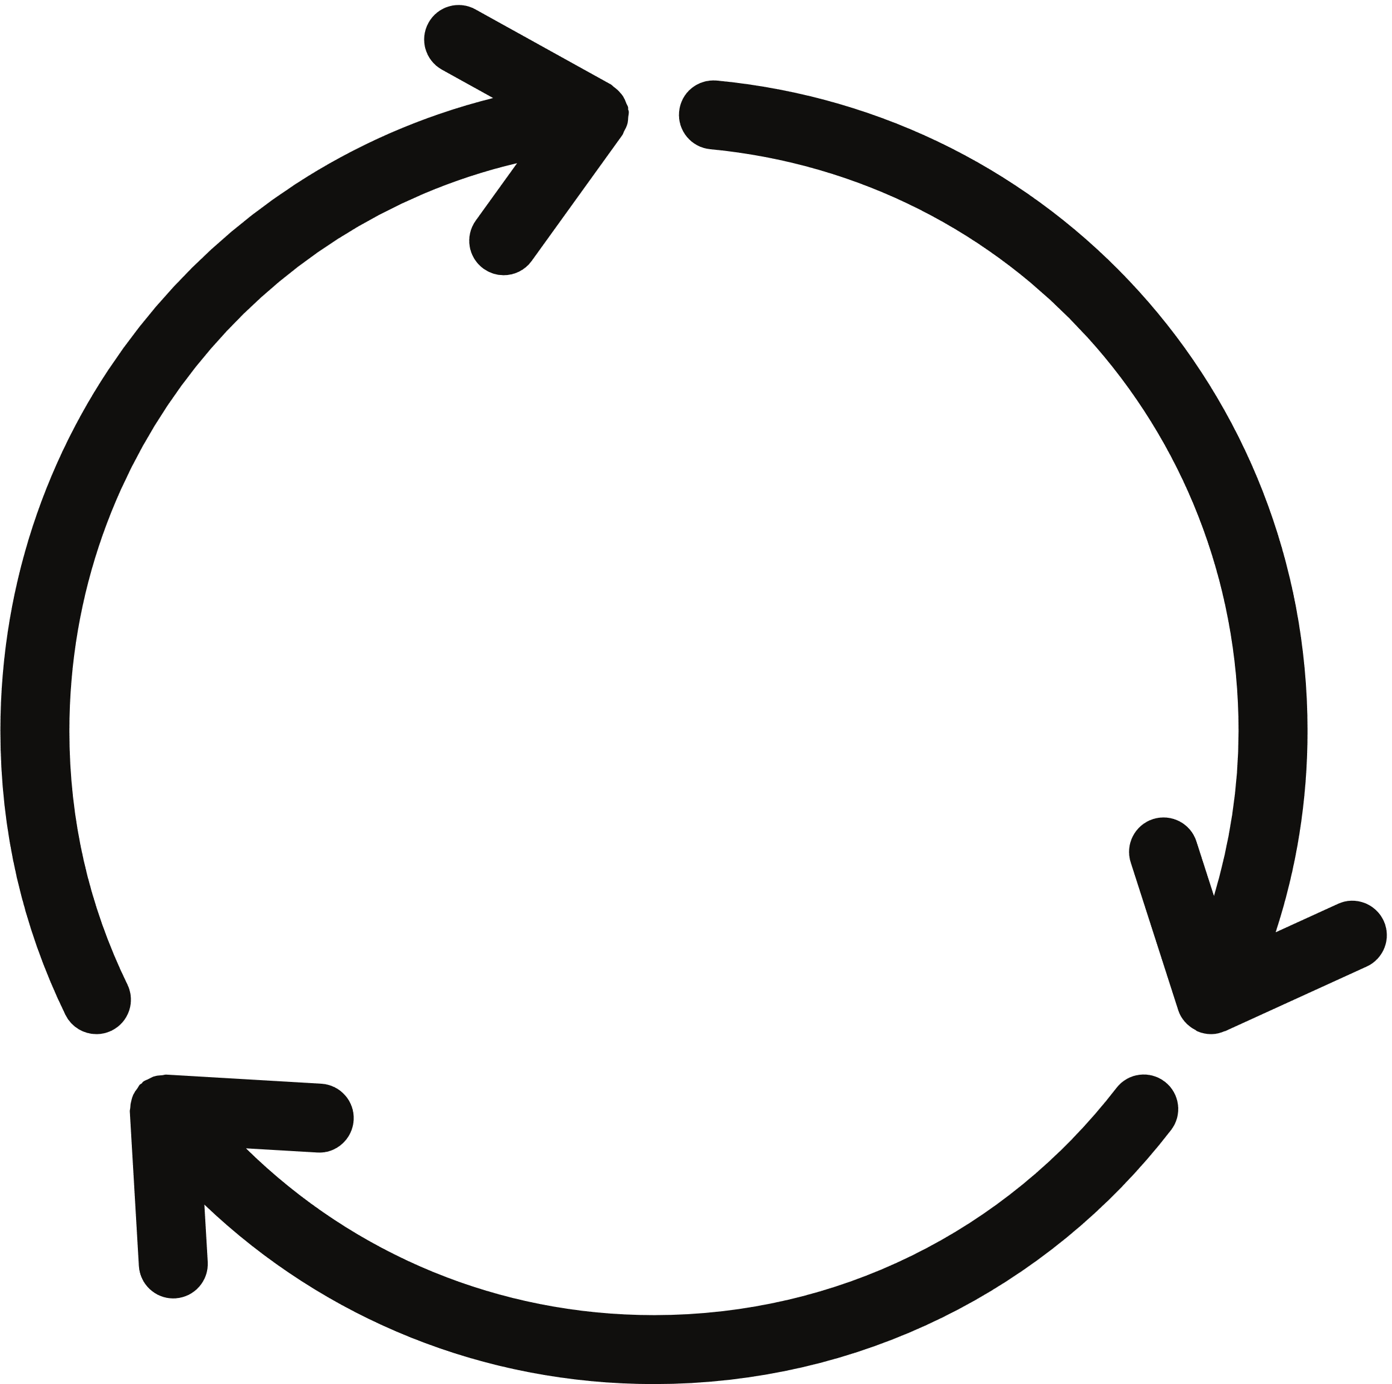
LESSON EXPLORATION
Breakout 1:
Germination
Breakout 2:
Plant Needs
Breakout 3:
Fish Needs
Breakout 4:
Aquaponics Cycle
Lessons
Notes:
https://docs.google.com/document/d/1tUOmG0OUJI-73sB_R5LRZA7yMCBqKCK0pU9Kb3K4PPA/edit

Slide 8
Materials Provided
Back to the Roots Water Garden
Restart Kit
pH testing strips
Additional Materials
FAQs Section
Video Help
Instruction booklet
Additional curriculum
Notes:
https://backtotheroots.com/pages/water-garden-new-frequently-asked-questions

Slide 9
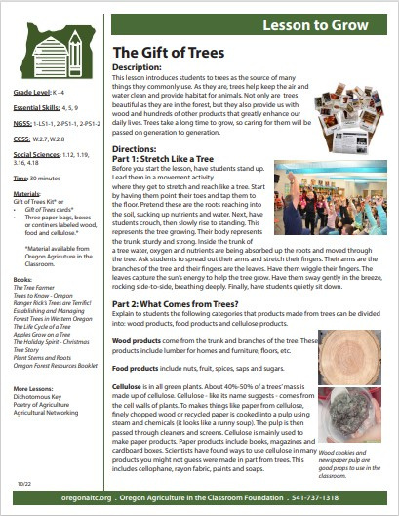
Curriculum
Lesson Plans
Oregon based lesson plans
Curriculum Matrix
National program’s lesson database
Notes:
https://docs.google.com/document/d/1tUOmG0OUJI-73sB_R5LRZA7yMCBqKCK0pU9Kb3K4PPA/edit

Slide 10
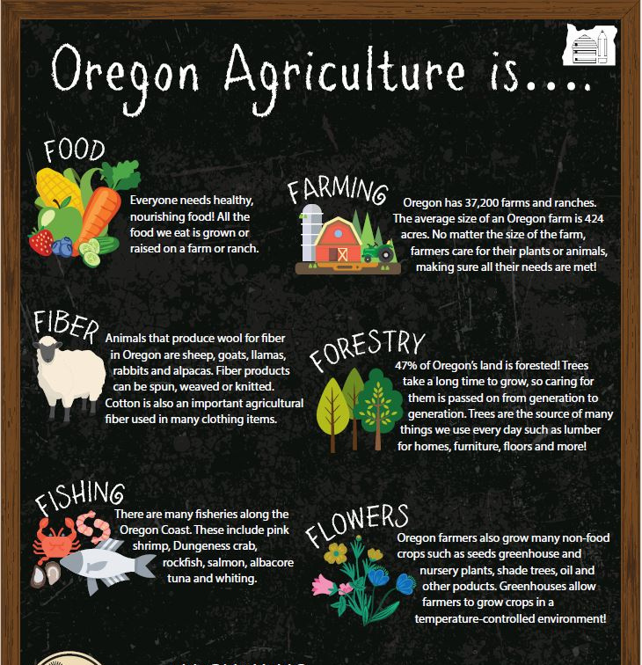
OREGON AITC PROGRAMS
Lending Library
Kits
Calendar Art Contest

Slide 11
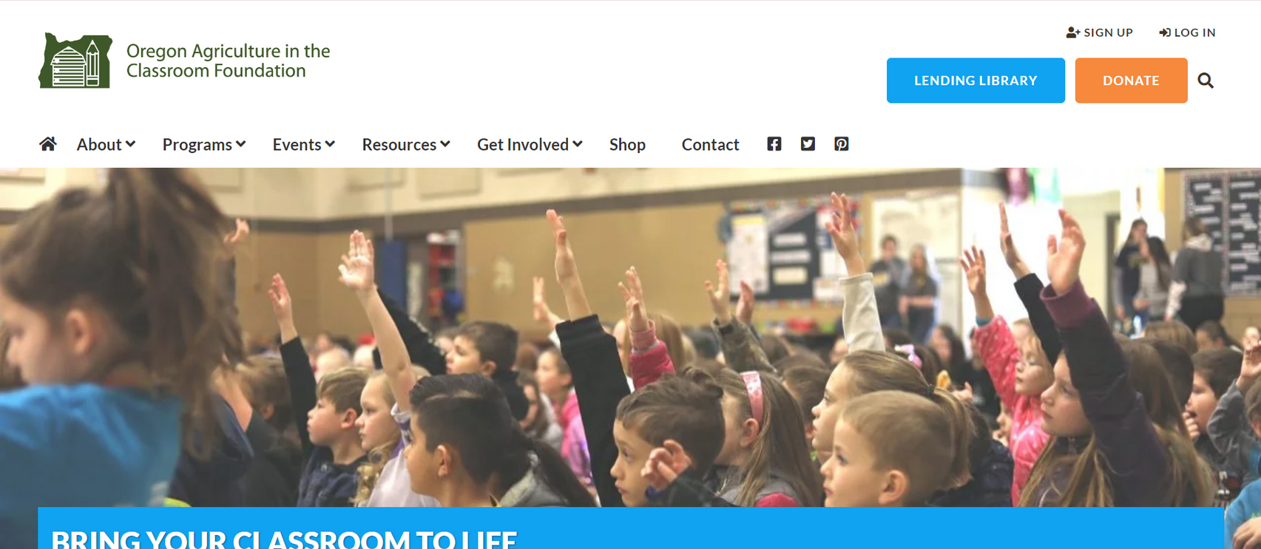
CHECK OUT ALL OUR RESOURCES ON OUR WEBSITE!
https://oregonaitc.org/

Slide 12
Evaluation
Notes:
https://oregonaitc.org/workshop-evaluation/

Slide 13
Thank You!
Oregon Agriculture in the Classroom
200 Strand Ag Hall
Corvallis, OR 97331
541-737-1318
Hanna VanDeWalle, Education Programs Coordinator
Hanna.VanDeWalle@oregonstate.edu
Jade Davidson, Executive Director
Jade.Davidson@oregonstate.edu

