Slide 1
Jade Davidson Evelyn Tedrick RyLee Demianew

Slide 2
Workshop Overview
What is Oregon Agriculture in the Classroom?
Exploring Classroom Resources
Website Overview

Slide 3
Program Information
Mission
To help students grow in their knowledge of agriculture, the environment and natural resources for the benefit of Oregonians today and in the future.
Overview
Agriculture is used as a context to teach core subject standards
Cross-curricular hands-on materials and lessons geared towards core standards for all educators
K-12, public, private, homeschool, afterschool, extracurricular, in all 36 counties of Oregon
Supported by the agricultural community

Slide 4
Curriculum Exploration
Station 1
Station 2
Station 3
Station 4
Station 5
Feat Kit 1 – Where Should Development Go?
Feat Kit 2 – Geography and Climate for Agricultural Landscapes
Virtual Field Trip Exploration
2025 Literacy Project Overview
Grown in Oregon Map

Slide 5
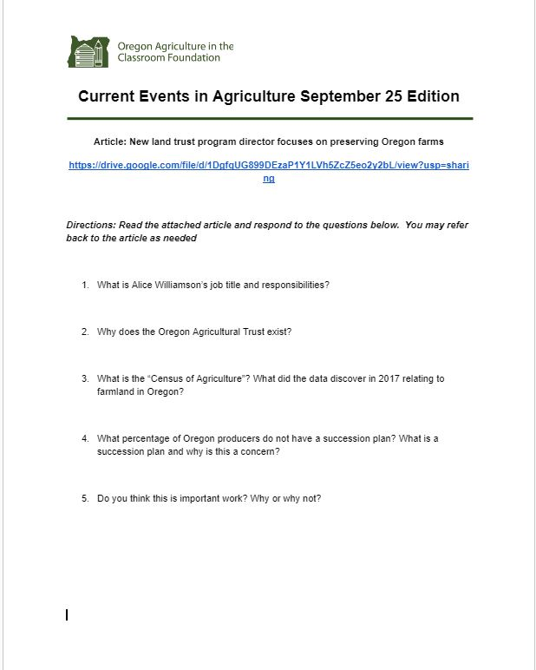
Oregon AITC Resources
Current Events
Weekly e-newsletter blast featuring a relevant agricultural story
Five key questions to engage your students about the weekly article
Engage students in culture, geography, social studies, language arts, and more

Slide 6
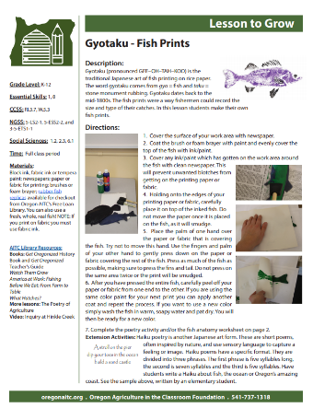
Oregon AITC Programs
Curriculum
Downloadable lessons that provide grade level, time, materials, and NGSS and CCSS, math, social sciences standards alignment
Notes:
Resources - Oregon Agriculture in the Classroom (oregonaitc.org)

Slide 7
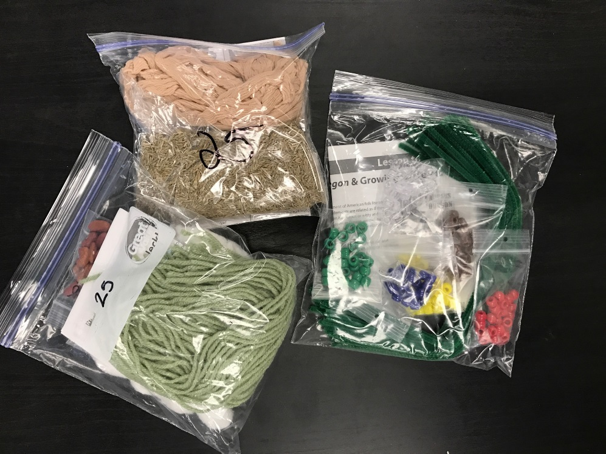
Oregon AITC Programs
Lending Library
Over 400 books, instructional units, resource kits, and other materials available for check out
All resources are free for you to order
Notes:
Resources - Oregon Agriculture in the Classroom (oregonaitc.org)

Slide 8

Oregon AITC Programs
Agricultural Literacy Project
The goal of the project is to increase awareness of where food comes from
Volunteer with Oregon AITC to bring agricultural literacy concepts into grades K-4 classrooms!
Notes:
Our Annual Agricultural Literacy Project has been going on for about 12 years. The goals are both to increase awareness of where food comes from, and also improving reading skills. Each year a book is chosen to highlight one aspect of the 6 F’s of Oregon agriculture, and we develop a lesson around it. Volunteers with some connection to agriculture go into classrooms, read the book, and go through the lesson with students and talk about their role in farming or forestry, etc.
We are always looking for good children’s books, so let us know if you have a favorite!

Slide 9
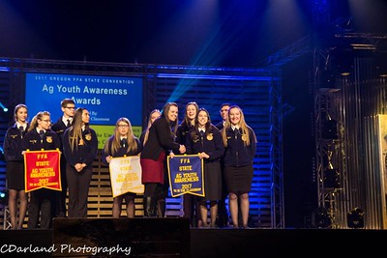
Oregon AITC Programs
Agricultural Advocacy Award
Apply today for the chance to receive funds for your students’ agricultural literacy projects
Awards presented annually at the FFA Convention in March

Slide 10
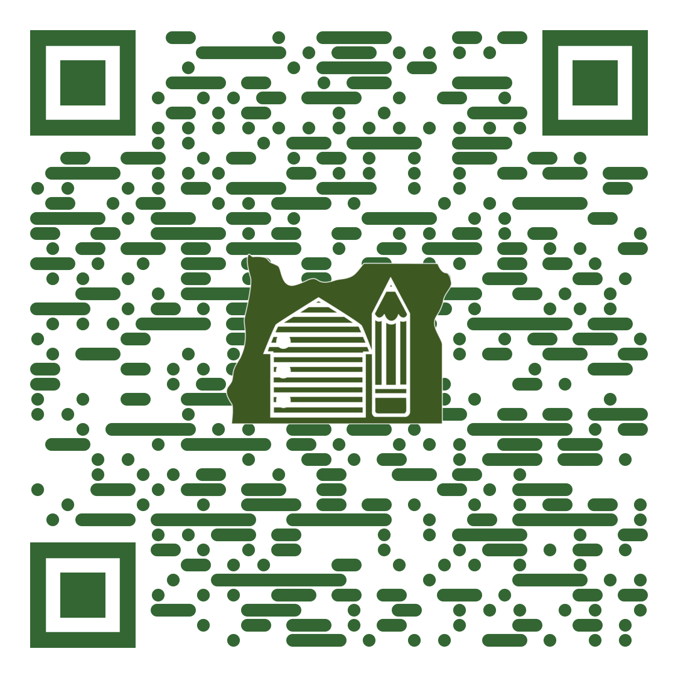
Oregon AITC Programs
Please complete an evaluation for today’s workshop.
Thank you!

Slide 11
Jade Davidson, PhD, Executive Director Jade.Davidson@oregonstate.edu
(541) 737-8629
Evelyn Tedrick, Education Programs Coordinator Evelyn.Tedrick@oregonstate.edu (541) 737-1318
RyLee Demianew, Education Resources Intern
RyLee.Demianew@oregonstate.edu

